Slide 1
Generating new spiders using generative neural networks (GAN)
Introduction
Key concepts
Dataset & Results
Topic
Plan
Motivation
Aim
DIPLOMA EXAM
Valery Burau
Thesis supervisor
prof. dr hab. Andrzej Pacut
1/21

Slide 2
Introduction
Key concepts
Dataset & Results
Topic
Plan
Motivation
Aim
Plan
1. Introduction
Topic
Plan
Motivation
Aim
2. Key concepts
Generative Adversarial Network (GAN)
Deep Convolutional Generative Adversarial Network (DCGAN)
Inception model
3. Dataset & Results
Dataset
Results
Conclusions & future work
2/21

Slide 3
Introduction
Key concepts
Dataset & Results
Topic
Plan
Motivation
Aim
Motivation
Creating multiple new objects for video games (different locations, different objects in any position). Moreover, the copyrights will not be violated.
Creating a new kind of animal, a new type of transport (e.g. a new car model) and furniture, an unusual view of building.
Creating a large database for a particular object.
3/21
Notes:
The first thing it can be created

Slide 4
Introduction
Key concepts
Dataset & Results
Topic
Plan
Motivation
Aim
Aim
Introduce the work of the GAN, which is the main idea and characteristics behind this network.
Determine what subtype of the GAN could be used to solve the problem of generating new types of spiders.
A thorough study of the selected GAN subtype.
Demonstrate the computational processes of the selected GAN subtype from the mathematical background.
5. Analyze the results and make conclusions from the made work.
4/21
Notes:
abc

Slide 5
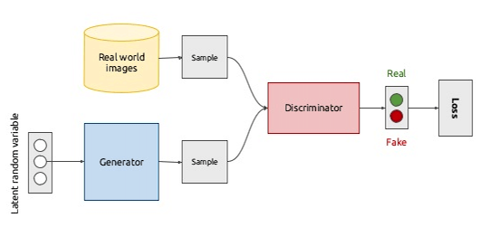
Introduction
Key concepts
Dataset & Results
Generative Adversarial Network (GAN)
Deep Convolutional Generative Adversarial Network (DCGAN)
Inception model
Generative Adversarial Network (GAN) - Main idea
There are two most important parts of creating this network:
Generator replicates real data to produce fake data.
Discriminator distinguishes real data from fake data.
The technique learns to generate new data with the same statistics as the training set.
The generative network generates candidates while the discriminative network evaluates them.
The generator trains based on whether it succeeds in fooling the discriminator.
Picture: GAN structure ¹
5/21
¹ Deep Learning for Computer Vision: Generative models and adversarial training (UPC 2016)

Slide 6
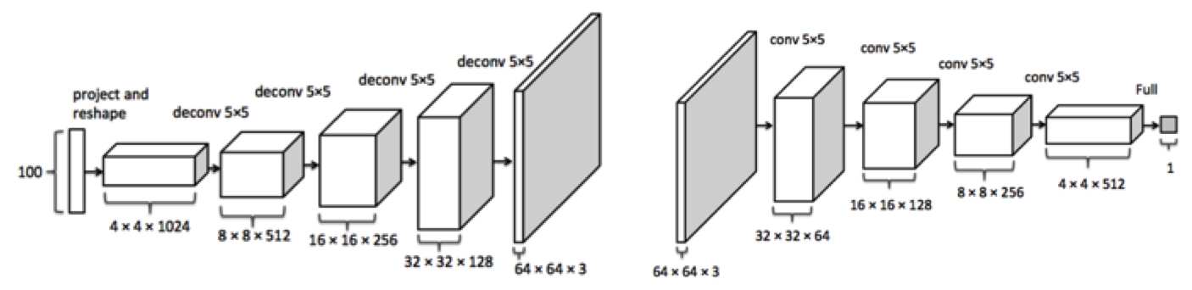
Introduction
Key concepts
Dataset & Results
Generative Adversarial Network (GAN)
Deep Convolutional Generative Adversarial Network (DCGAN)
Inception model
Deep Convolutional Generative Adversarial Network (DCGAN) ¹ – Idea
Generator
Discriminator
The generator is comprised of convolutional-transpose layers and ReLU activations.
The input is a latent vector (noise) 'z' and the output is a 3x64x64 RGB image.
The discriminator is made up of strided convolutional layers and LeakyReLU activations.
The input is a 3x64x64 input image and the output is a scalar probability that the input is from the real data distribution.
Picture: DCGAN structure ²
¹ DCGAN TUTORIAL
6/21
² Generative Adversarial Networks

Slide 7

Introduction
Key concepts
Dataset & Results
Generative Adversarial Network (GAN)
Deep Convolutional Generative Adversarial Network (DCGAN)
Inception model
DCGAN model – Loss function (Binary Cross Entropy loss function)
$${\left.l\left(x,y\right)=L=\{l_{1},…, l_{N}\right\}}^{T},{ l}_{N}=−[y_{N}∗log\left(x_{N})\right]+\left[{\left(1−y\right.}_{N})∗log\left(1−x_{N})\right]\right]$$
N is the batch size.
x_{n} is the input after discriminator/generator structure.
y_{n} is the expected output.
Losses:
d_loss = fake_loss(D_fake) + real_loss(D_real)
g_loss = real_loss(D_fake)
7/21

Slide 8
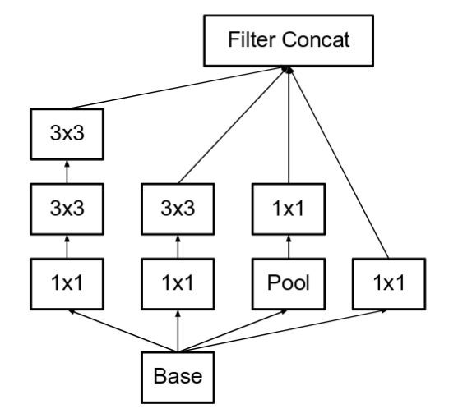
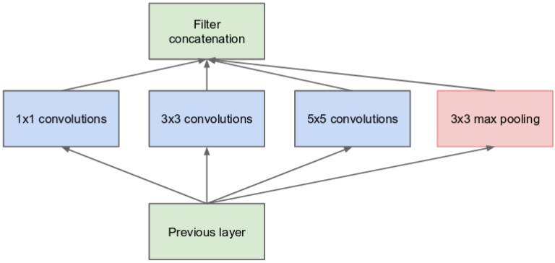
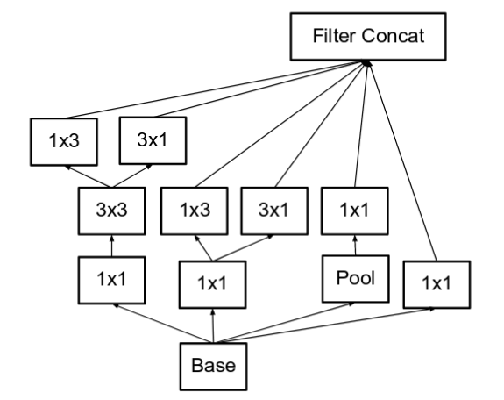
Introduction
Key concepts
Dataset & Results
Generative Adversarial Network (GAN)
Deep Convolutional Generative Adversarial Network (DCGAN)
Inception model
Inception model - Ideas
Picture: The naive inception model ¹
Picture: The inception v3 model, module „C" ¹
Picture: The inception v3 model, module "A" ¹
Improves a computational speed.
Gives usually best quality Images – saves more information about a training image.
8/21
¹ A Simple Guide to the versions of the Inception Network

Slide 9
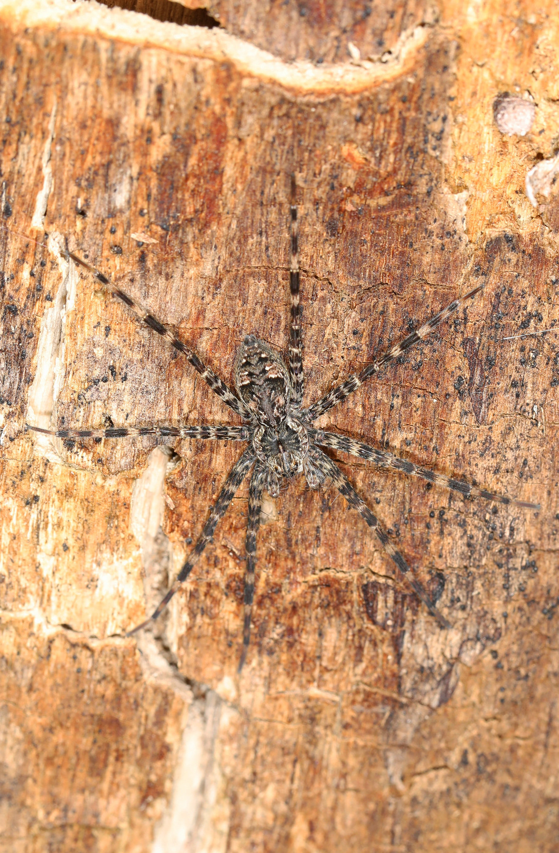
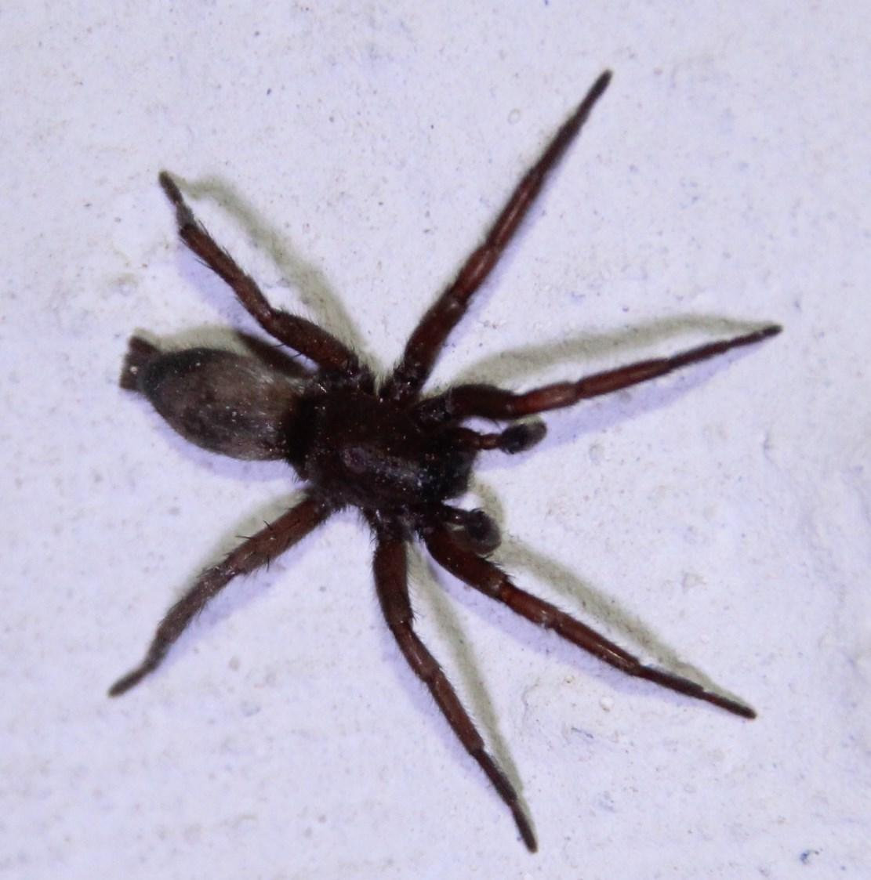
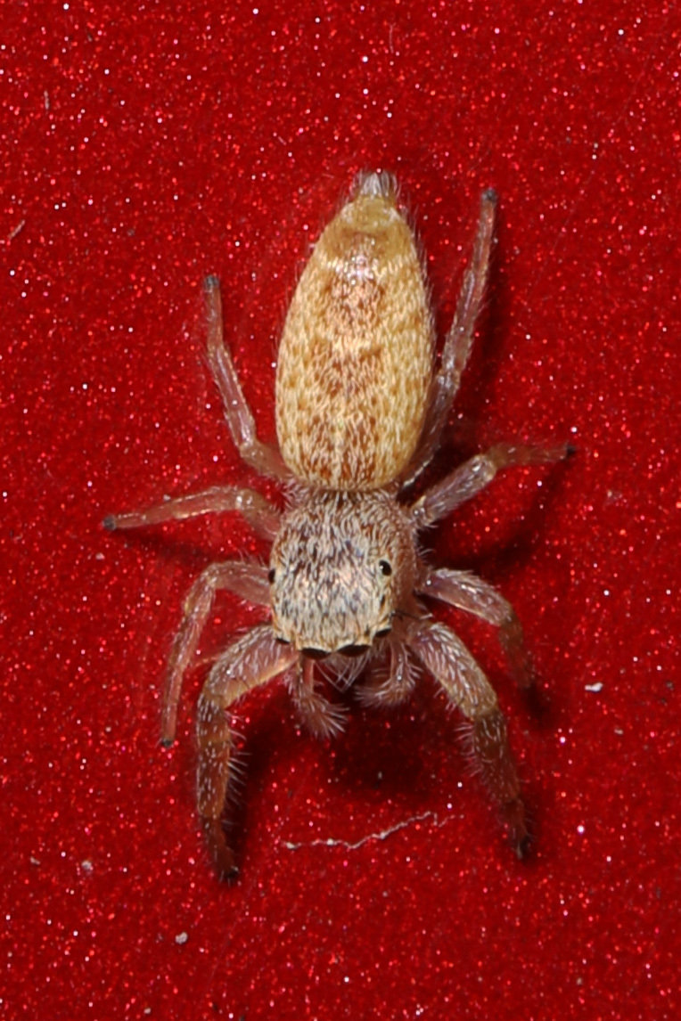
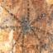
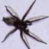
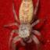
Introduction
Key concepts
Dataset & Results
Dataset
Results
Conclusions & future work
Dataset – Preprocessing (Part 1)
The final data set includes 21800 images of spiders.
Preprocessing part:
All images were checked manually (getting rid of bad images).
The remaining images were cropped and then resized to 3x64x64 size.
¹ Animal Classification
² Arthropod Taxonomy Orders Object Detection Dataset
³ Animals-10
⁴ Spider-recognition_dataset
9/21
⁵ atlas of living Australia

Slide 10
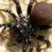
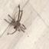
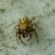
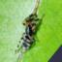
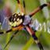
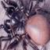
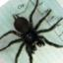
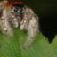
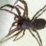
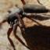
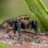
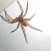
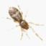
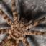
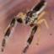
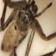
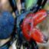
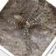
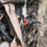
Introduction
Key concepts
Dataset & Results
Dataset
Results
Conclusions & future work
Dataset – Preprocessing (Part 2)
Picture: Different spider sizes
Picture: Different spider species
Picture: Spiders from different angles
Picture: Background with easy distinguishable spiders
Picture: Spiders without certain parts of the body
Picture: Background with difficult distinguishable spiders
10/21

Slide 11
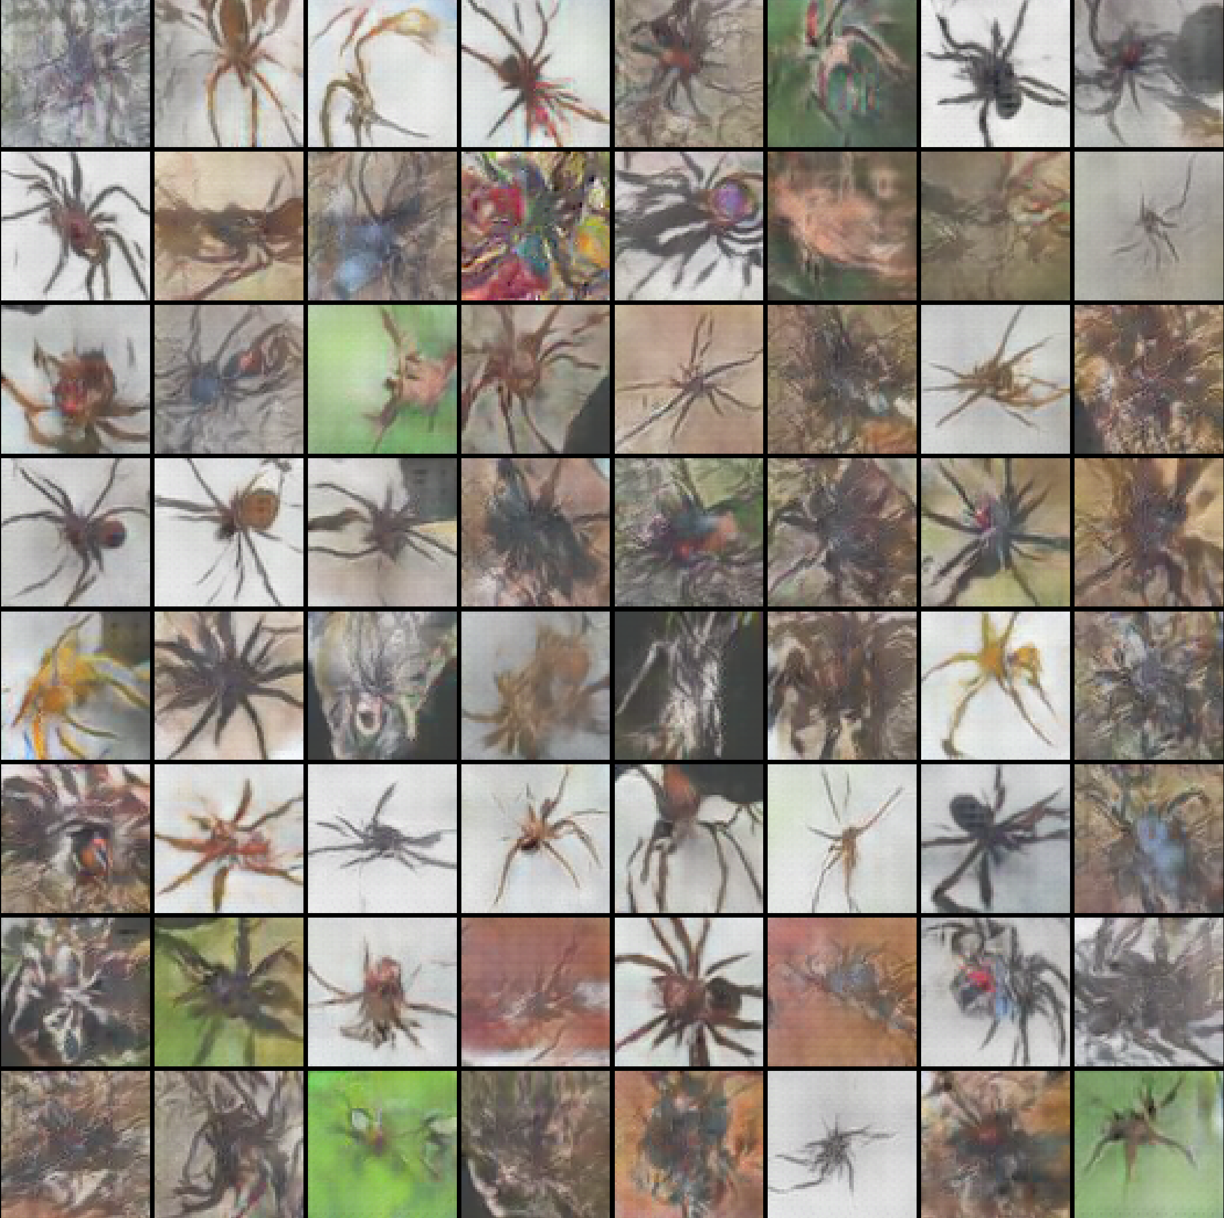
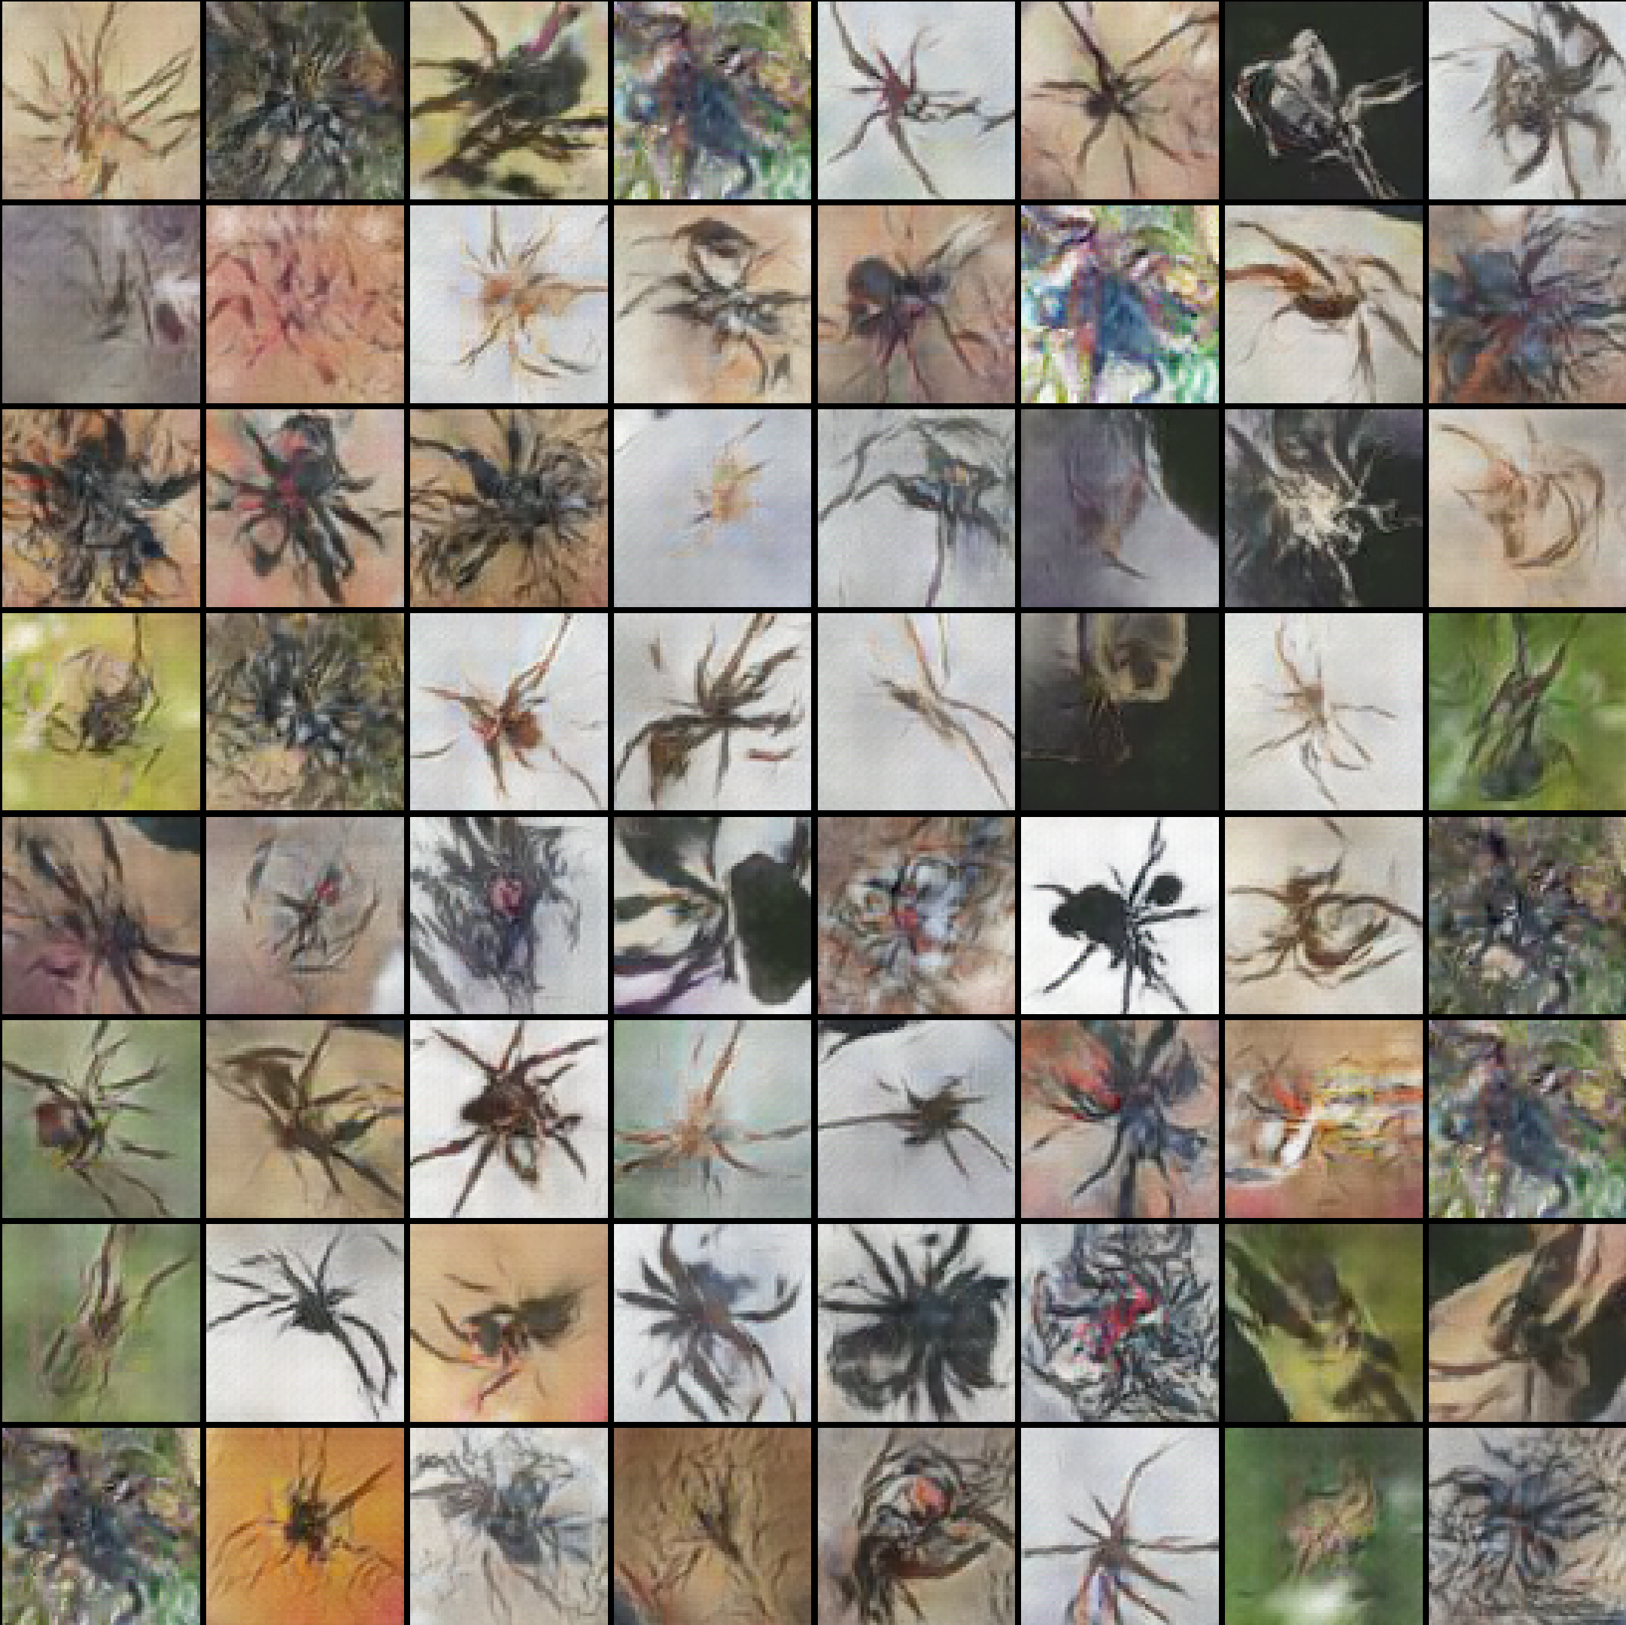
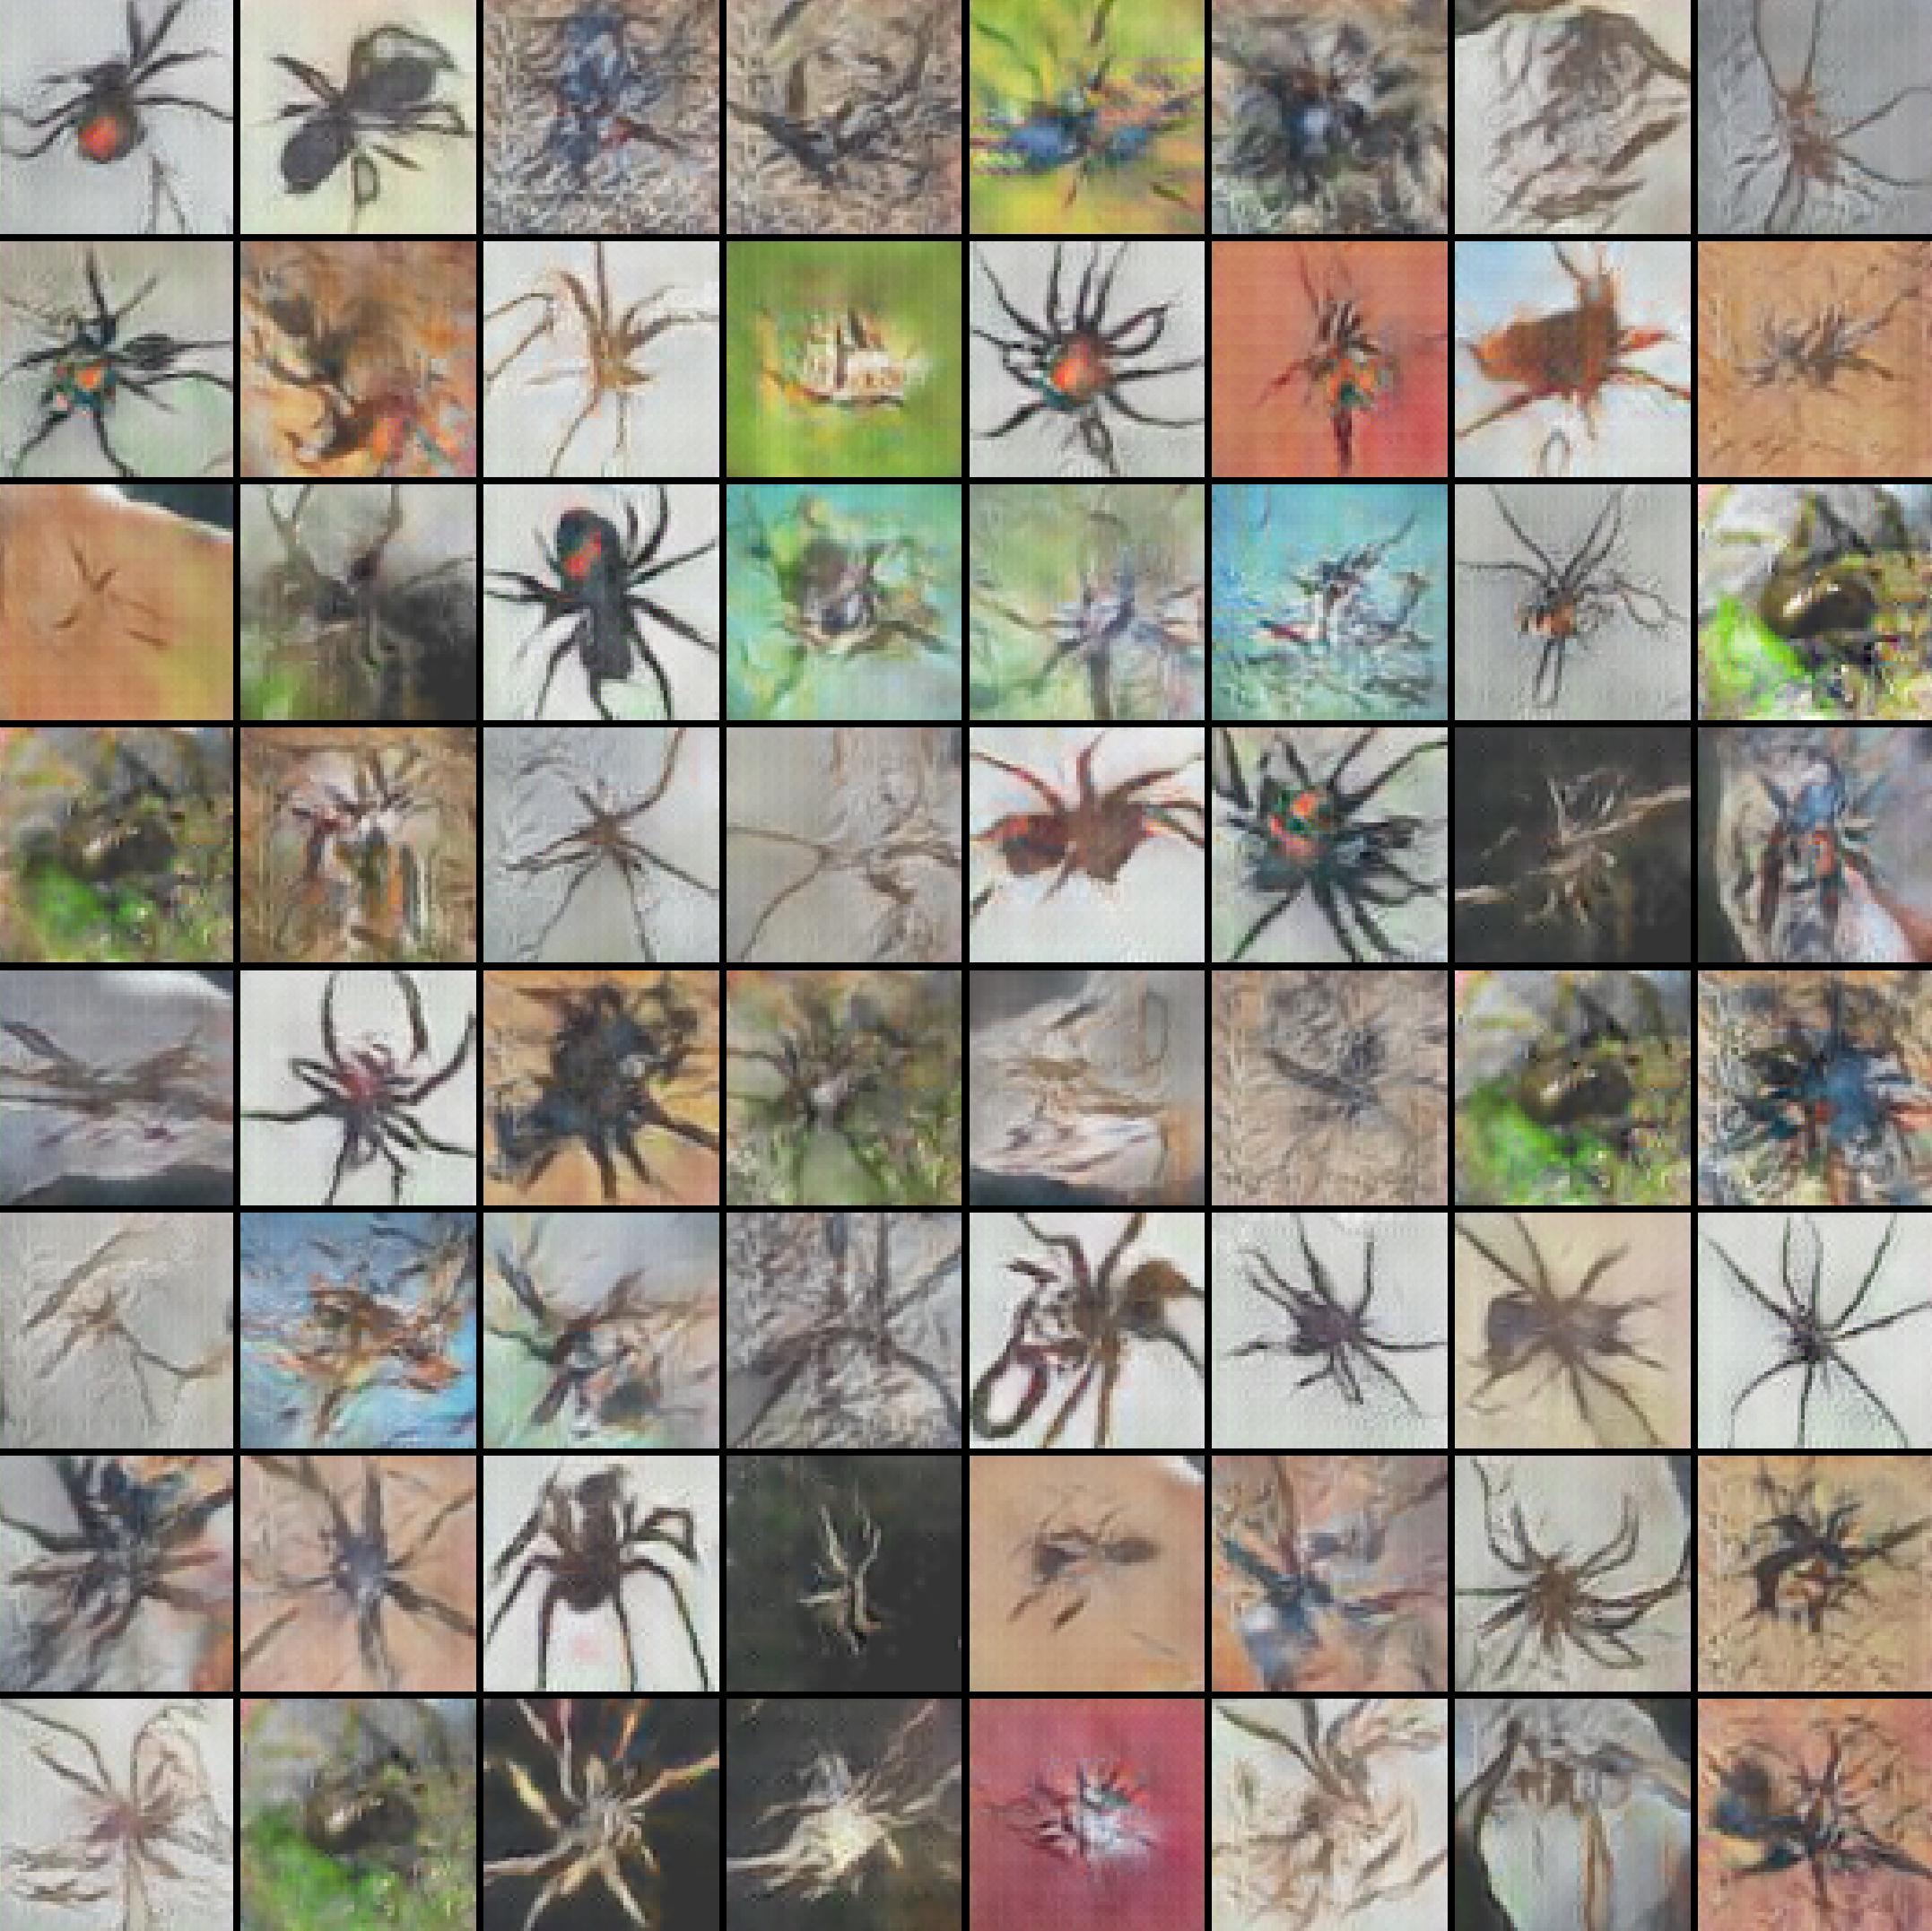
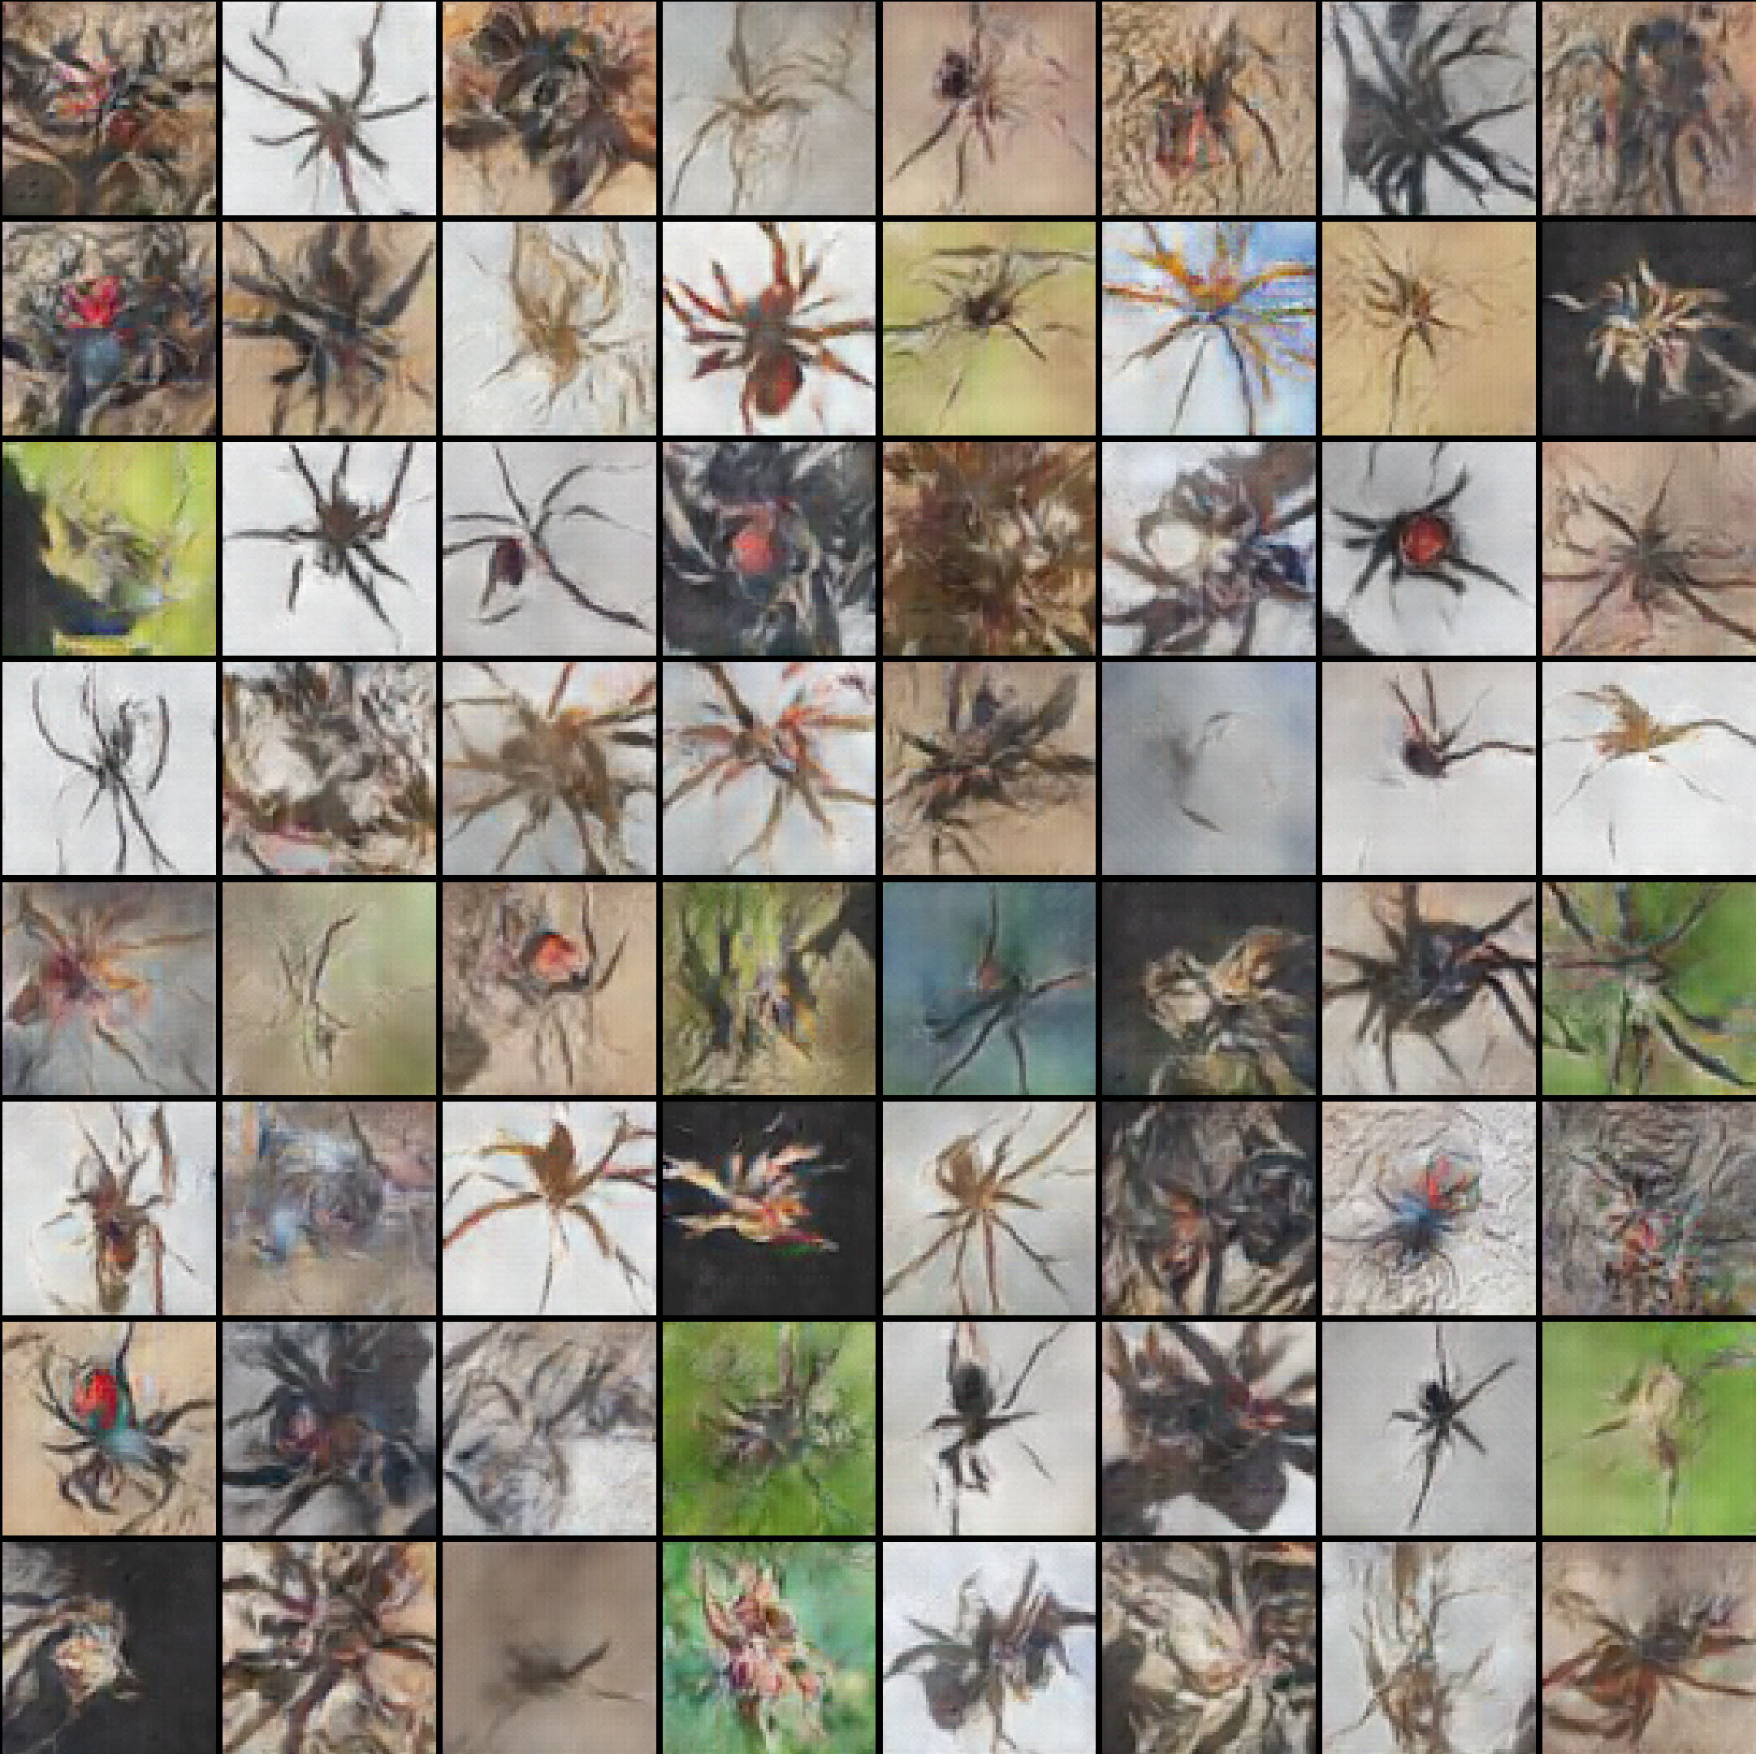
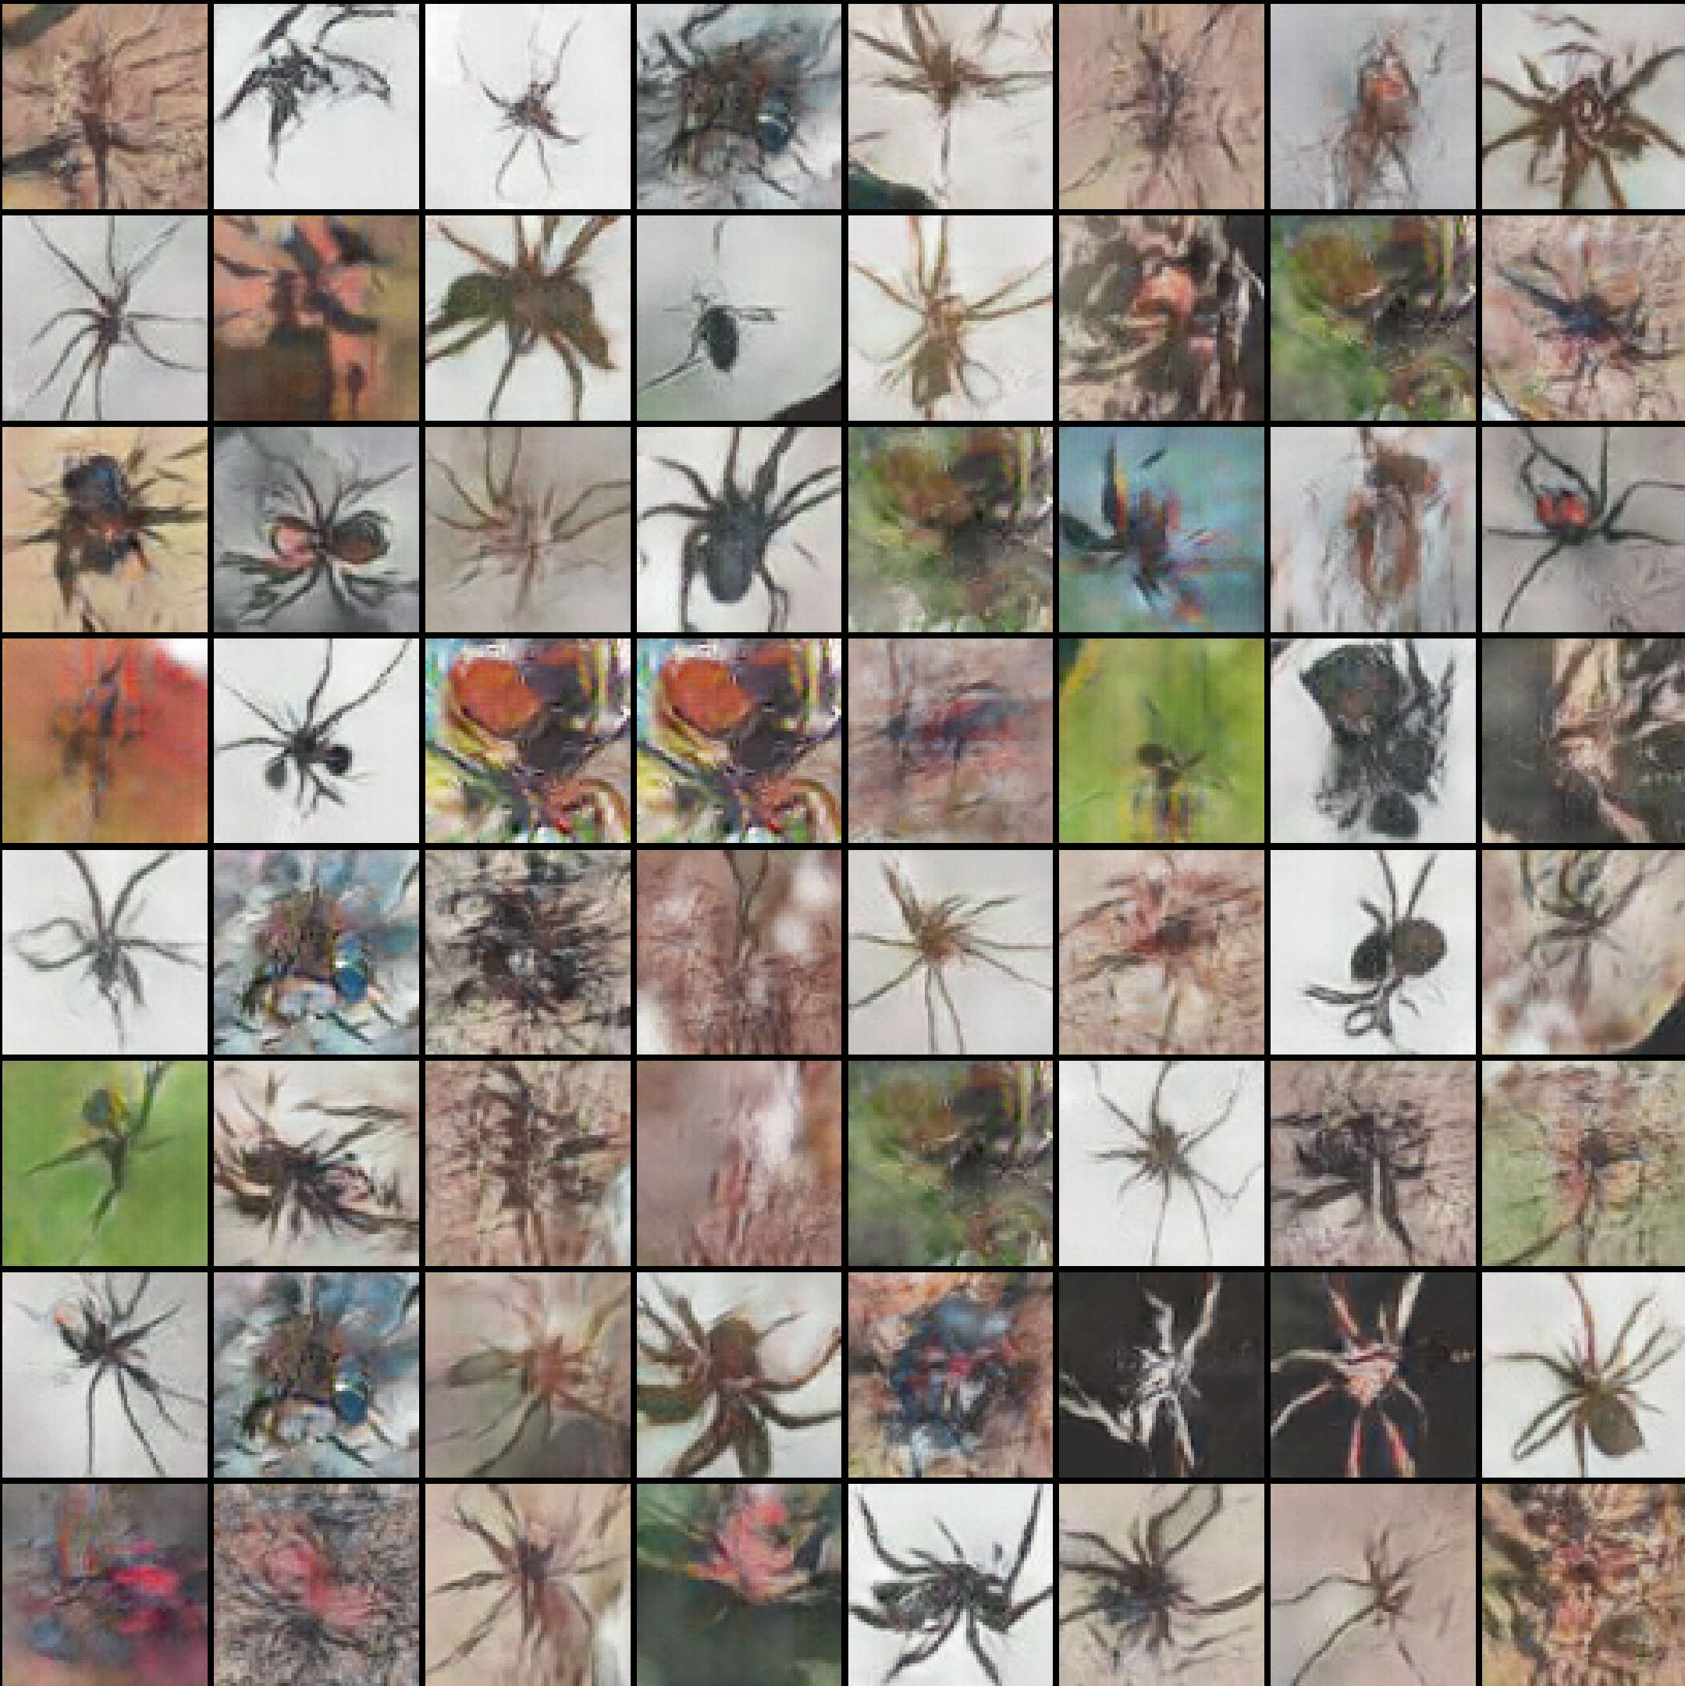
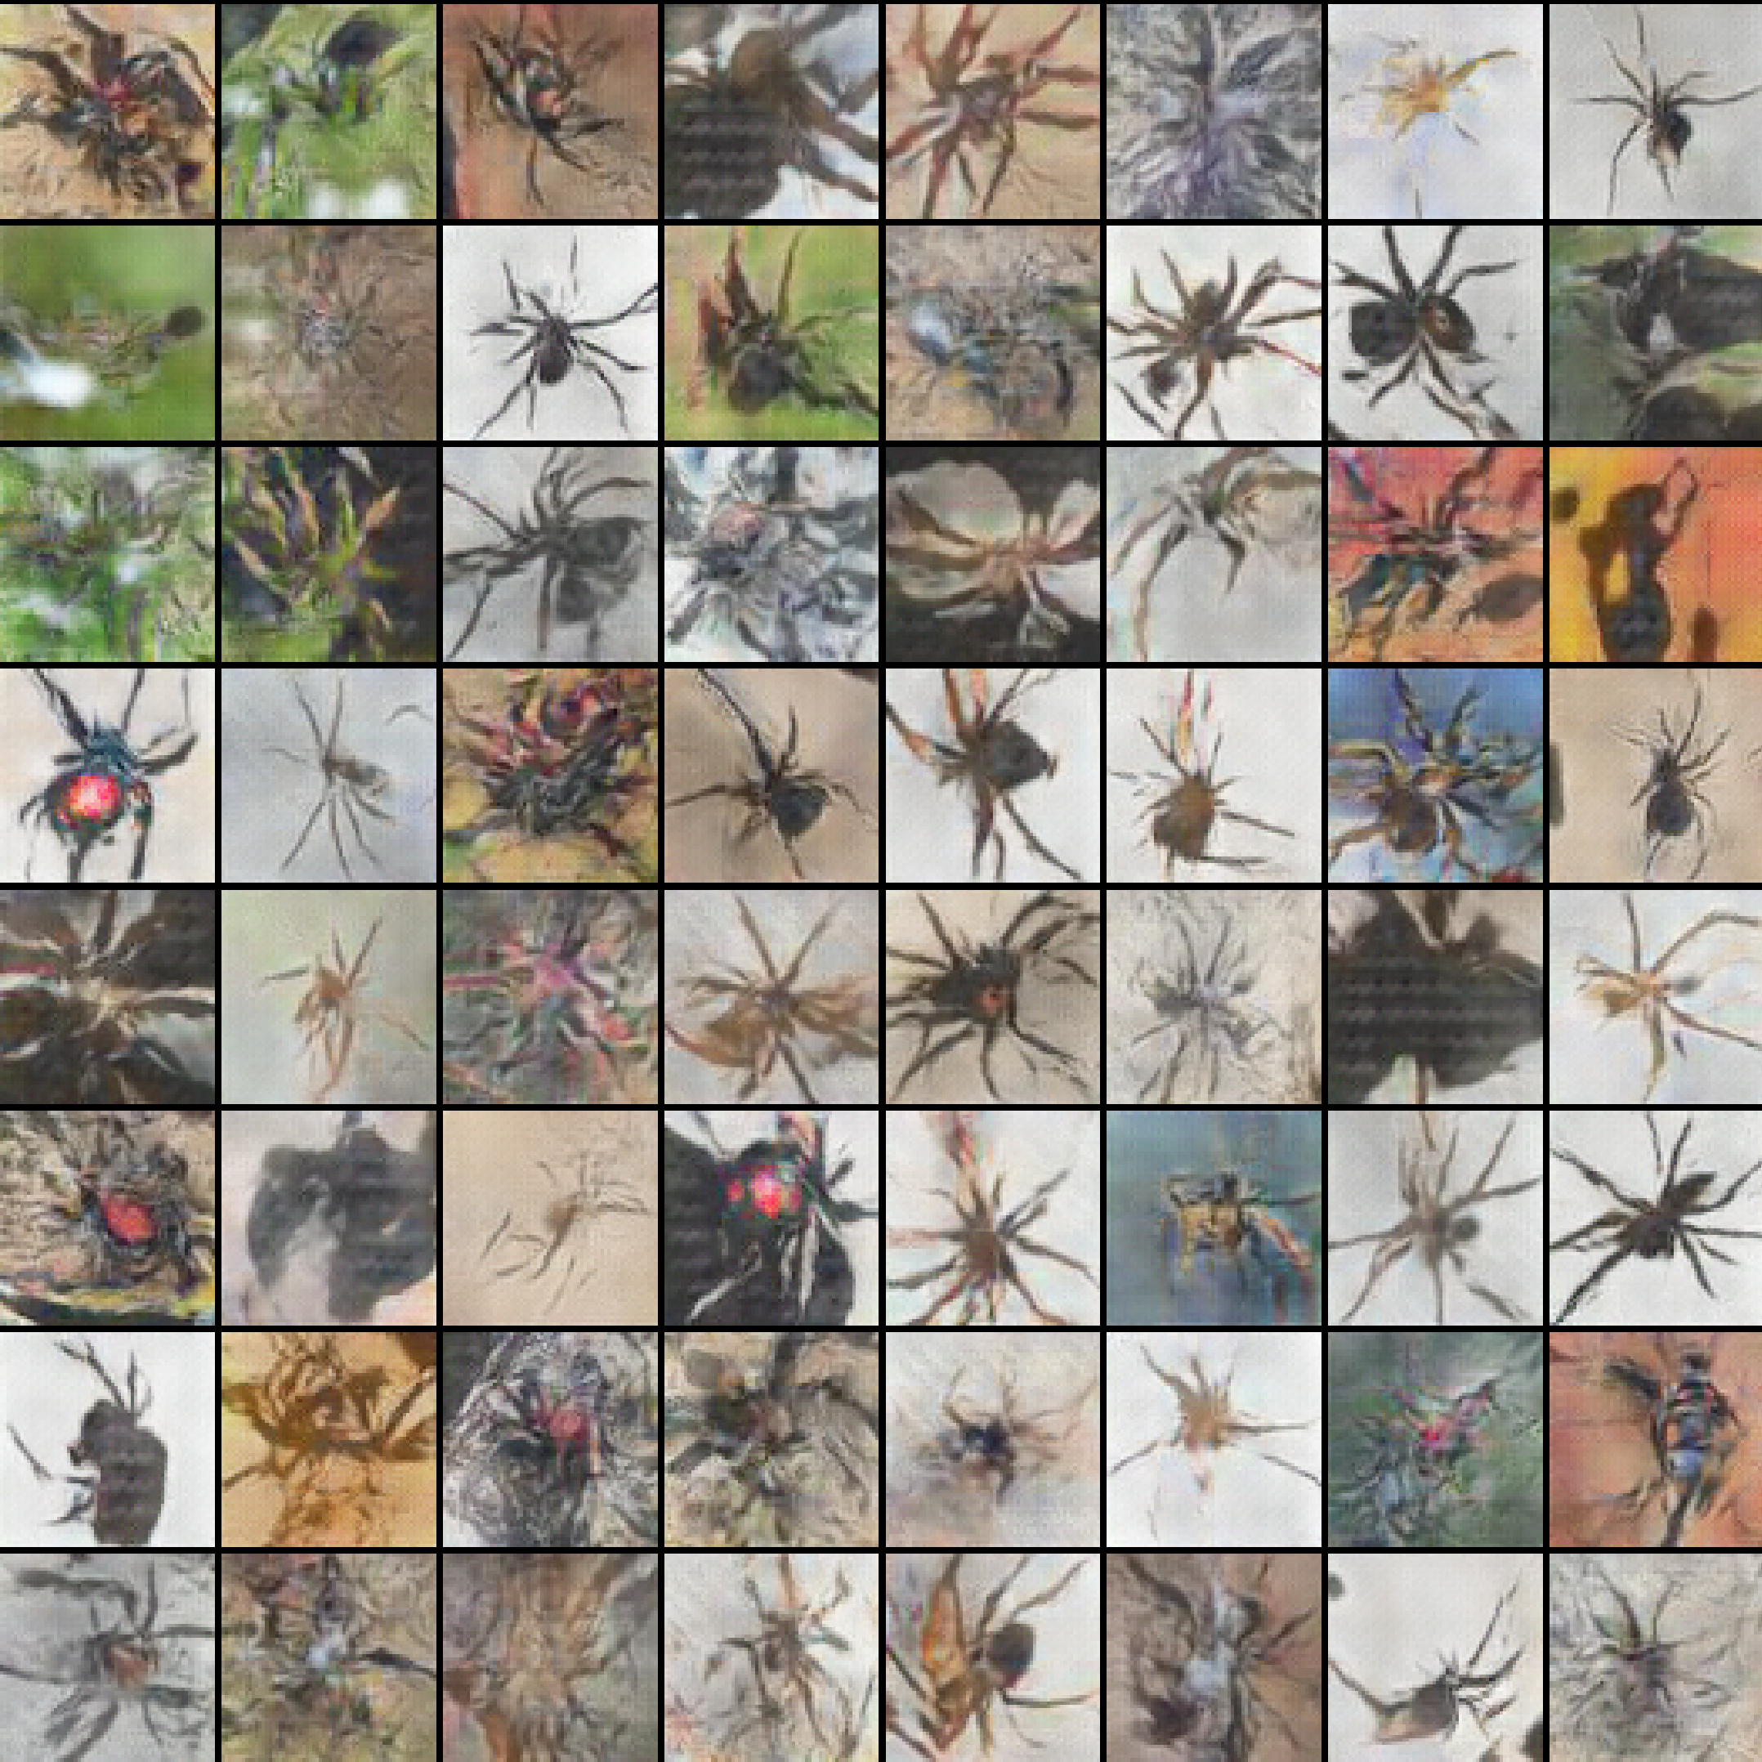
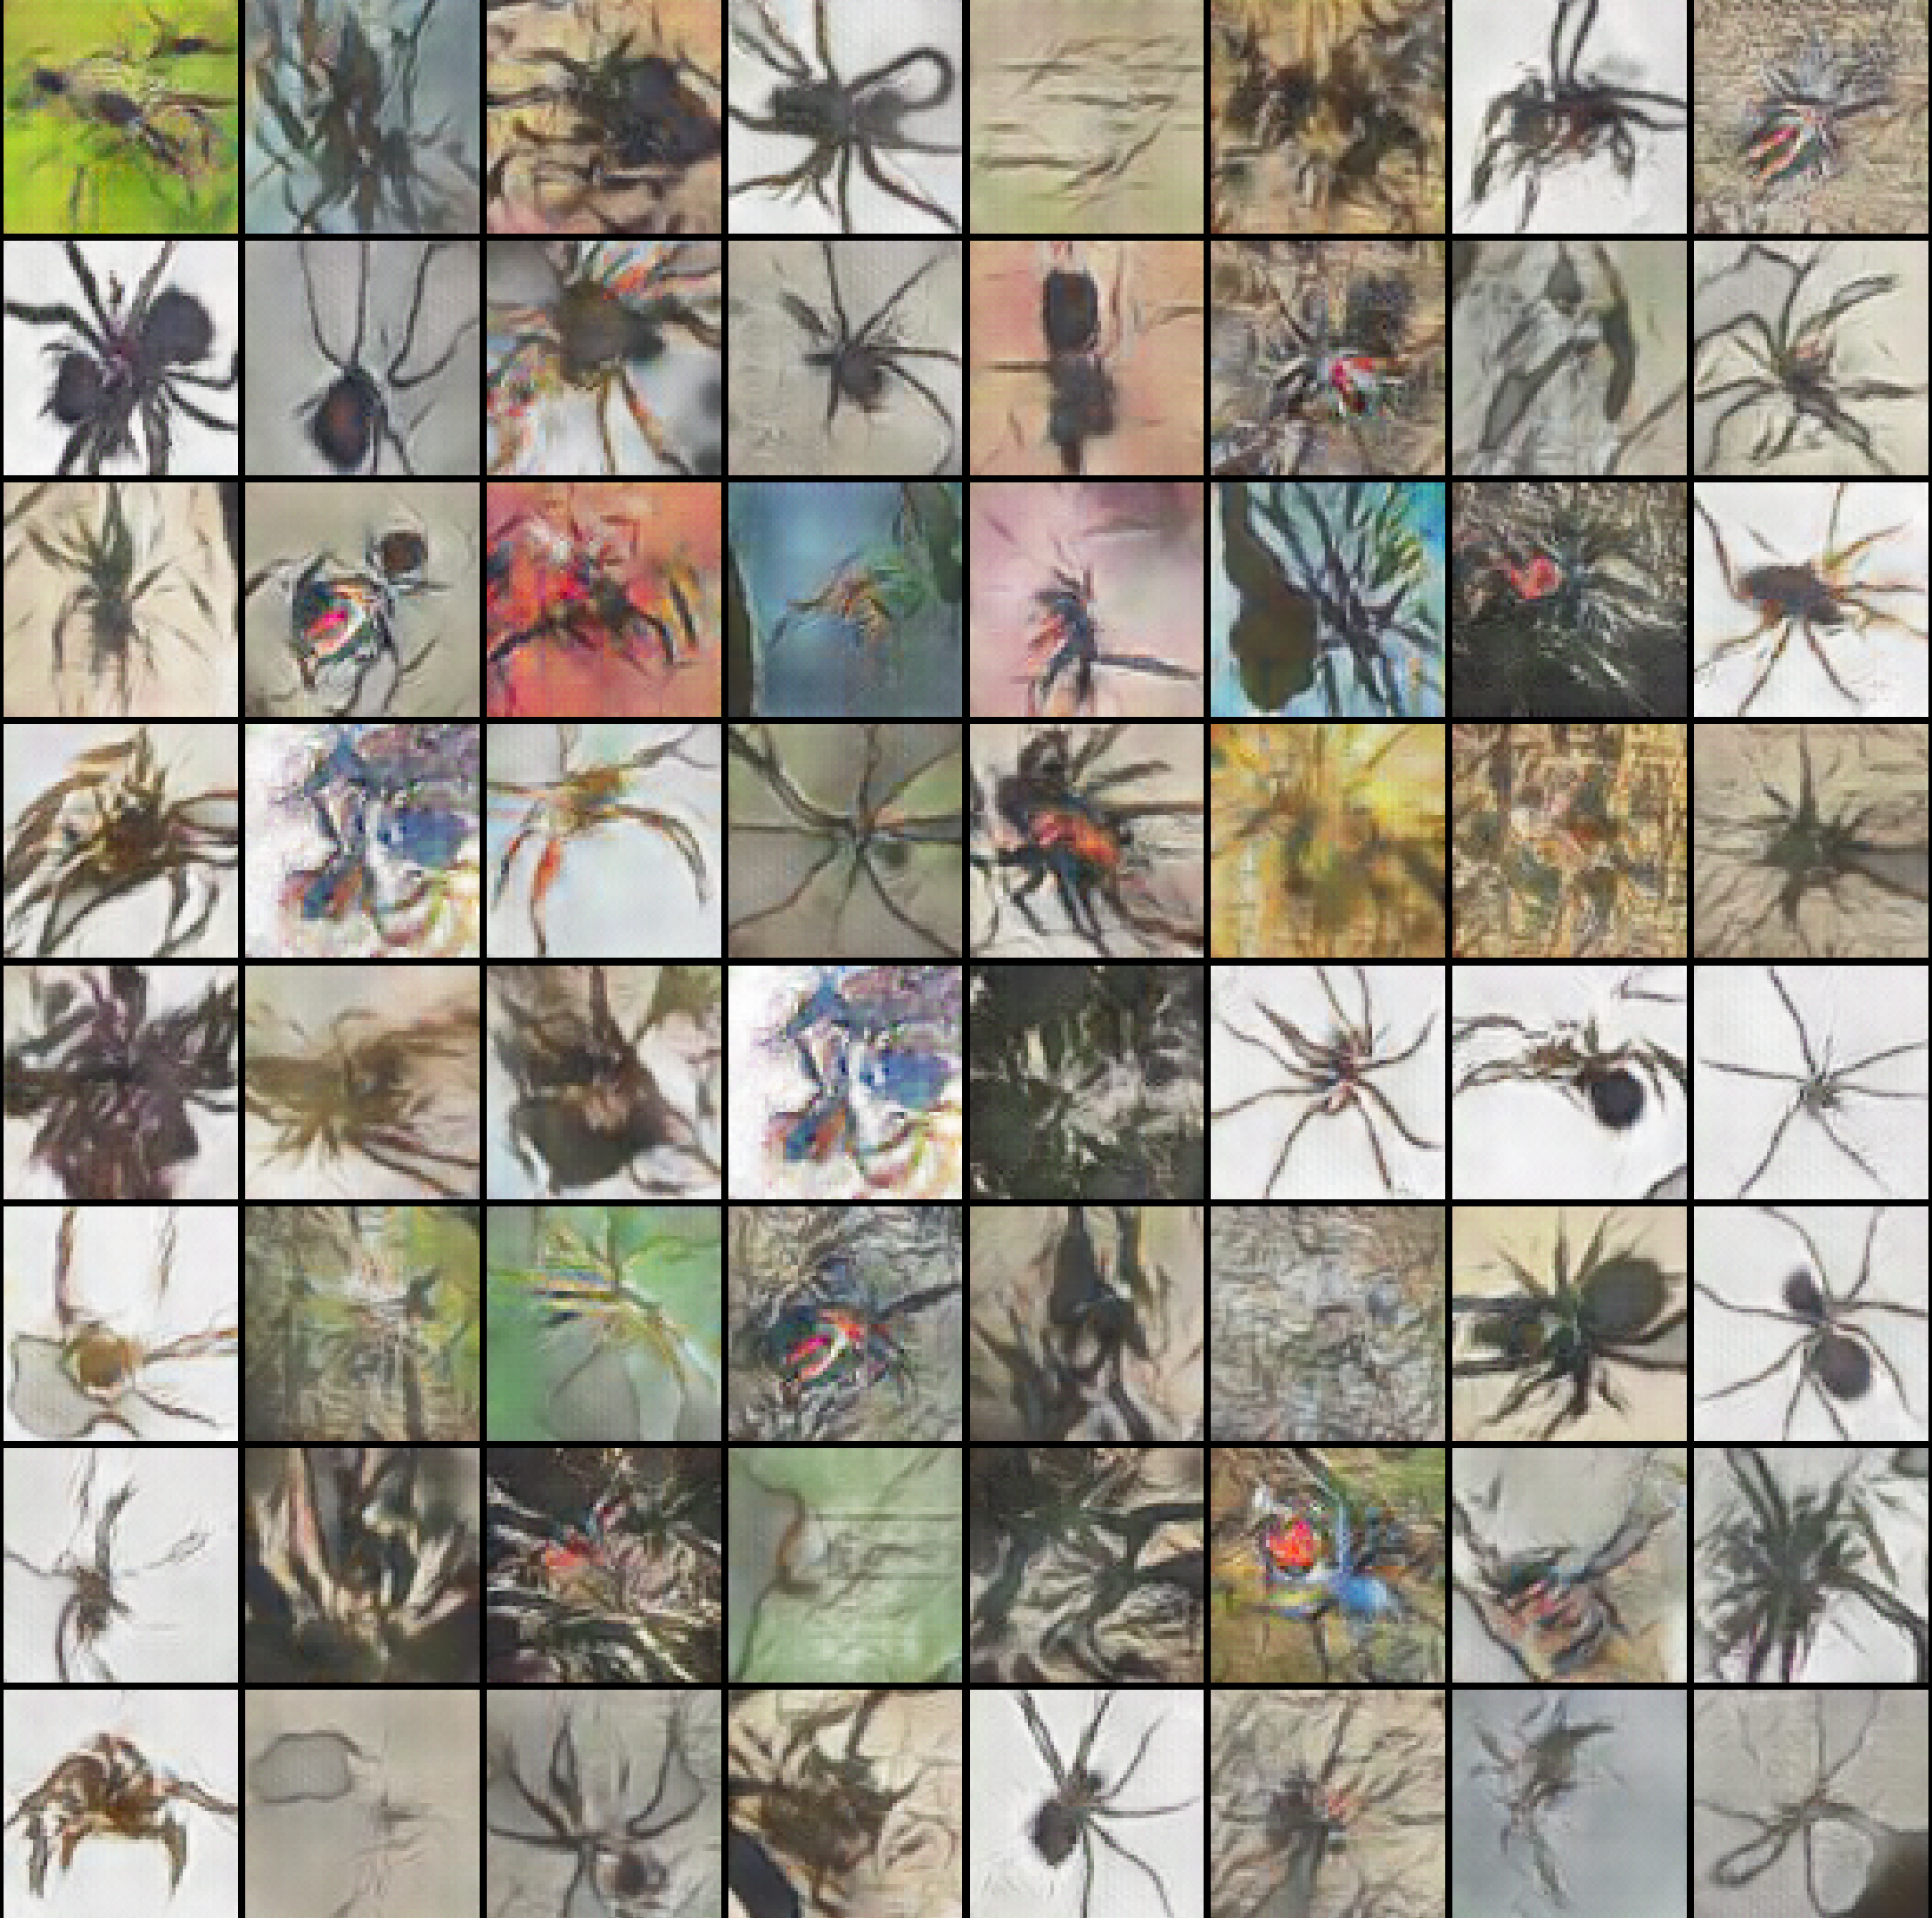
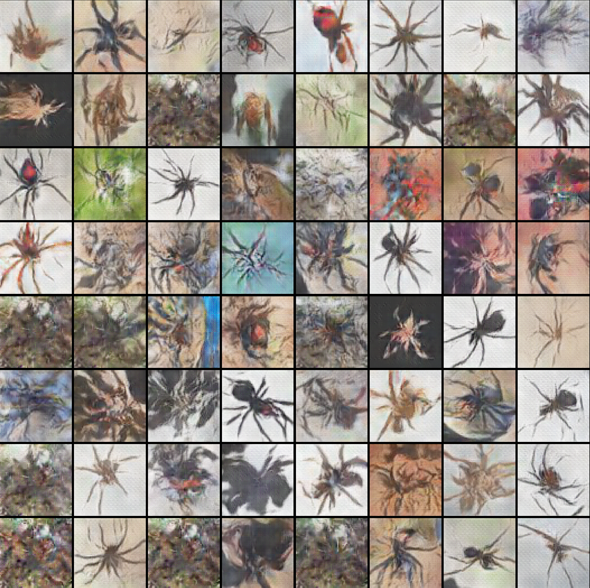
Introduction
Key concepts
Dataset & Results
Dataset
Results
Conclusions & future work
Results – Generated spiders (Influence of batch size) (Part1)
Picture: Generated spiders, batch size=32, [Adam(650 epoch); RMSprop(400 epoch)]
Picture: Generated spiders, Batch size=128 [Adam(650 epoch); RMSprop(300 epoch)]
Picture: Generated spiders, batch size=64 [Adam(450 epoch); RMSprop(400 epoch)]
Picture: Generated spiders, batch size=256 [Adam(650 epoch); RMSprop(950 epoch)]
11/21
Notes:
Visual examination of samples by human is one of the common and most intuitive ways to evaluate GANs.
Due to the lack of time, only the most important results are presented here.

Slide 12
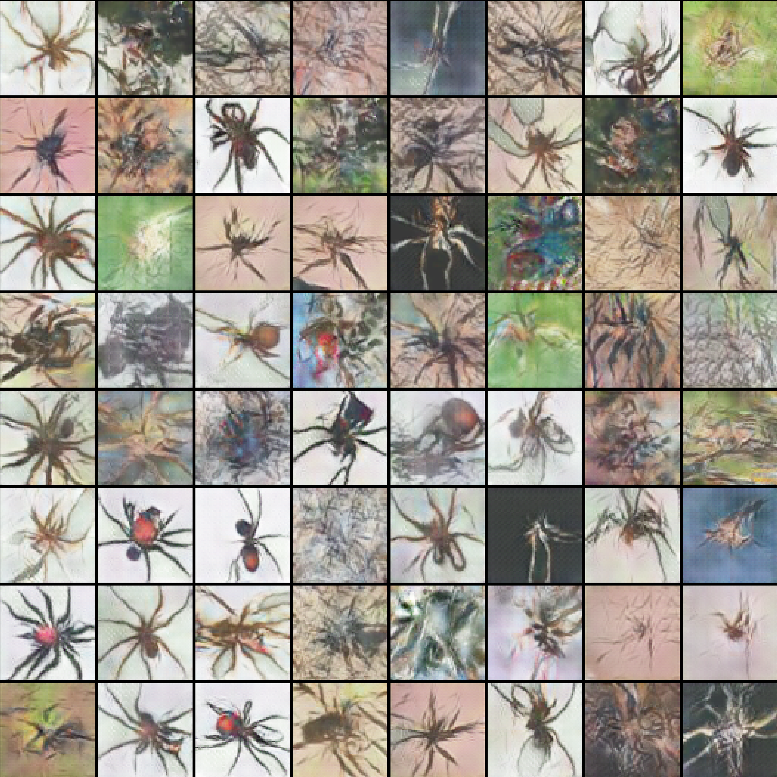
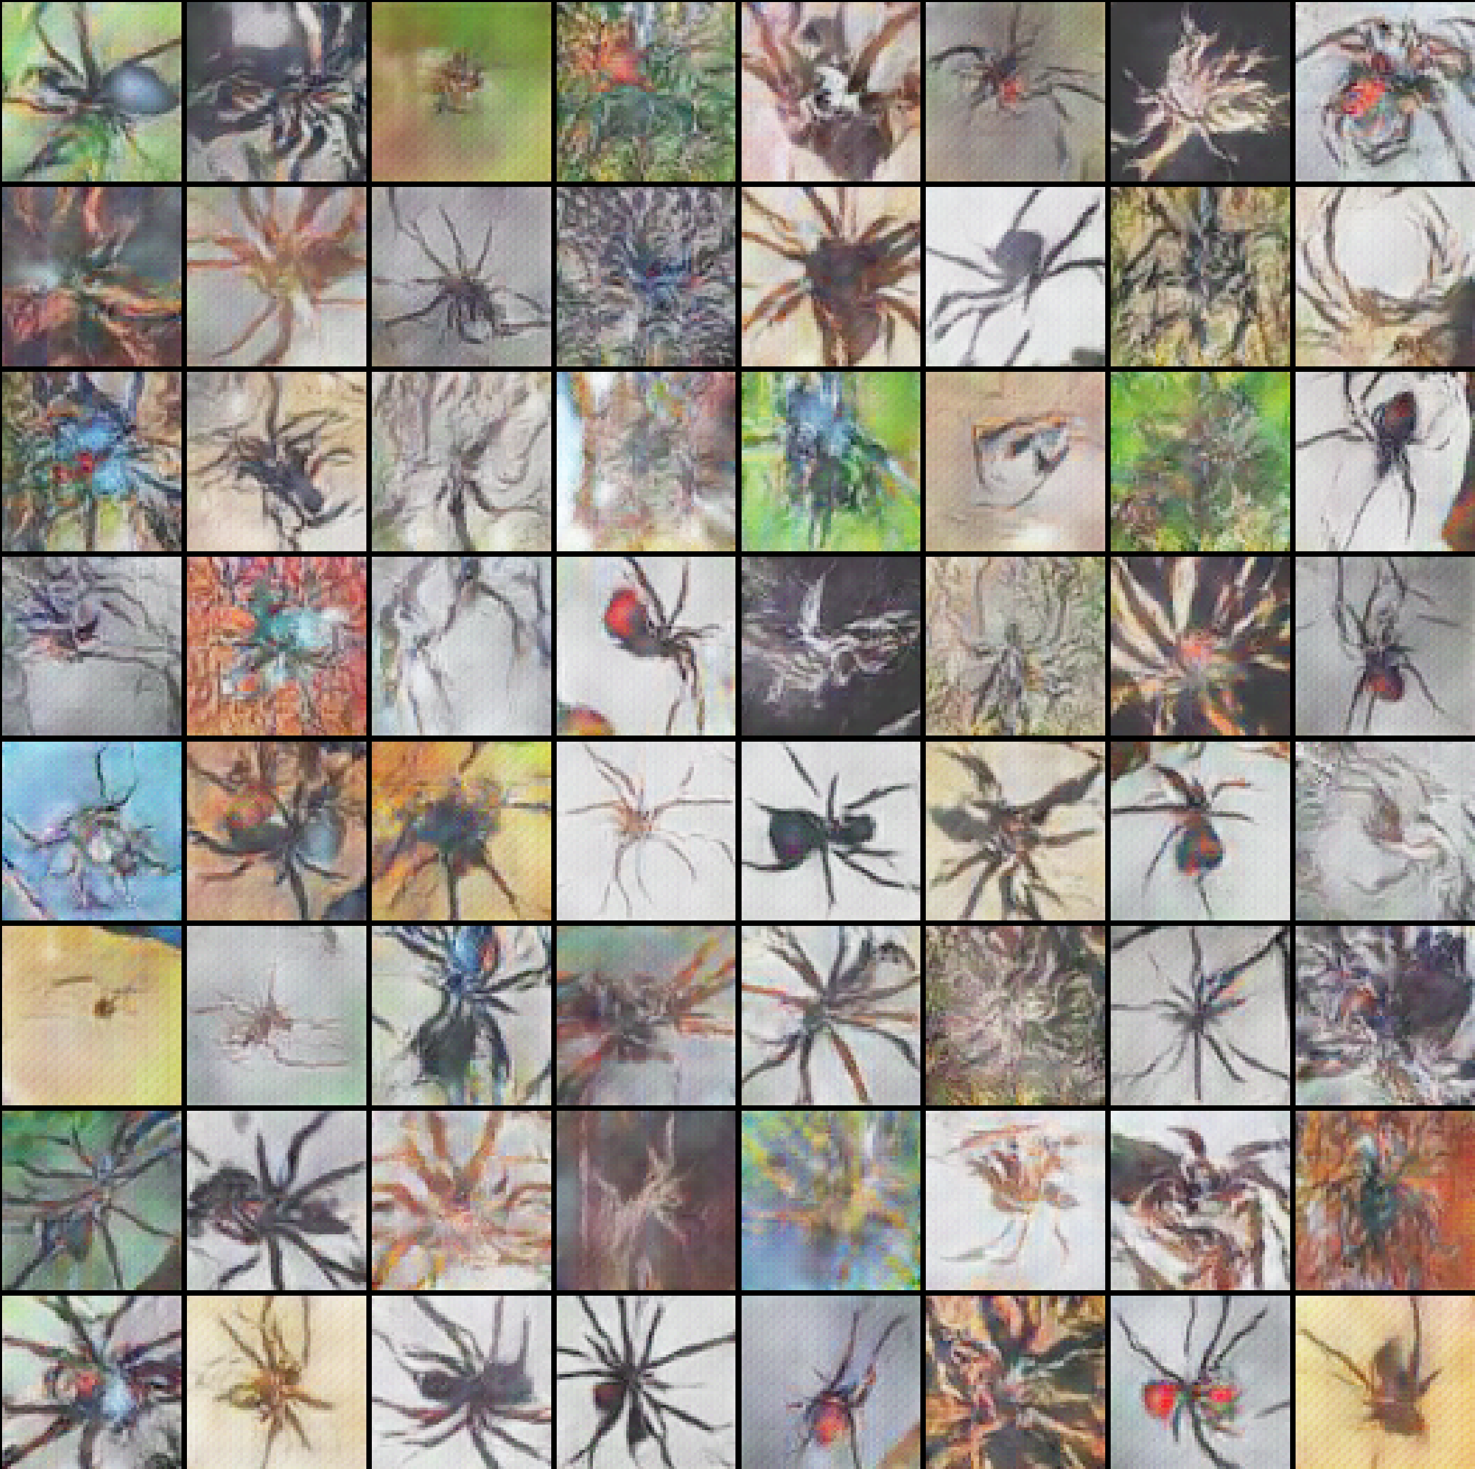
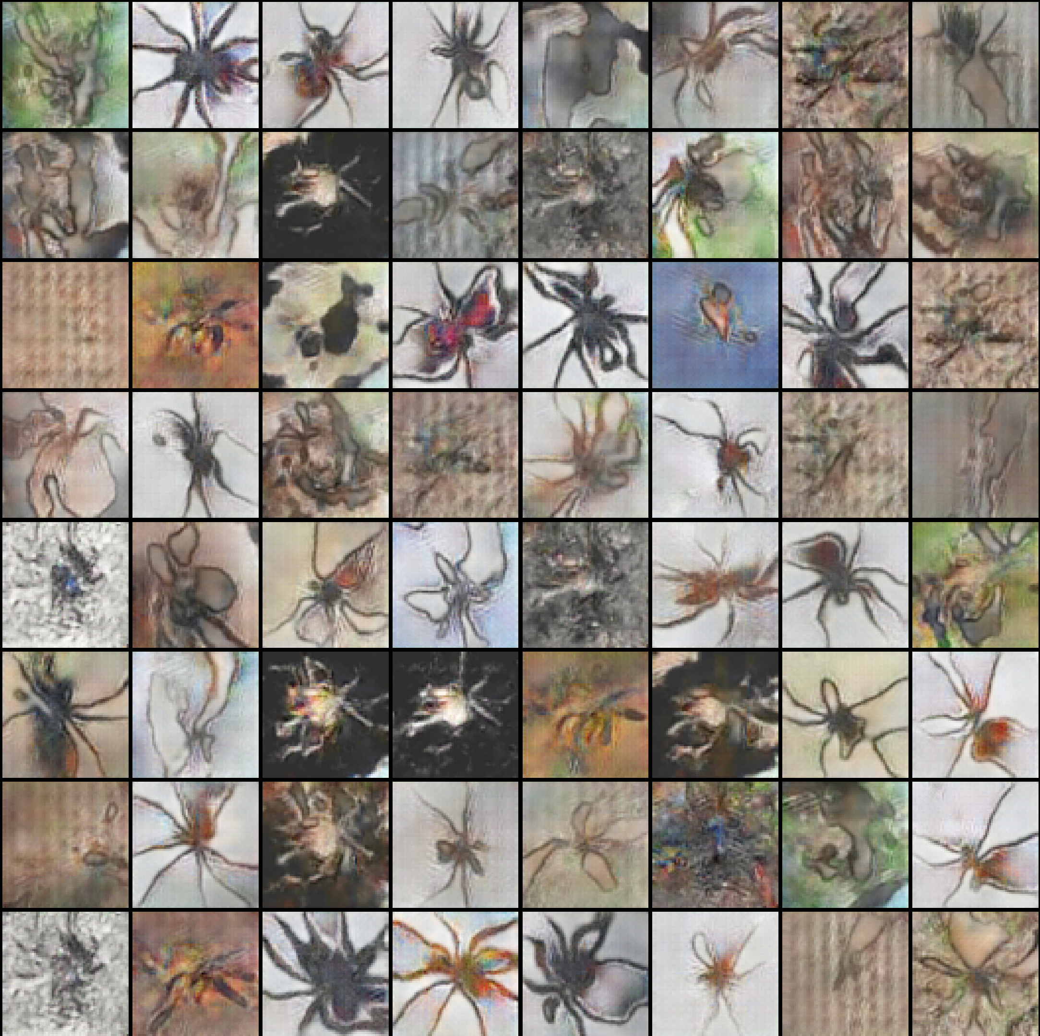
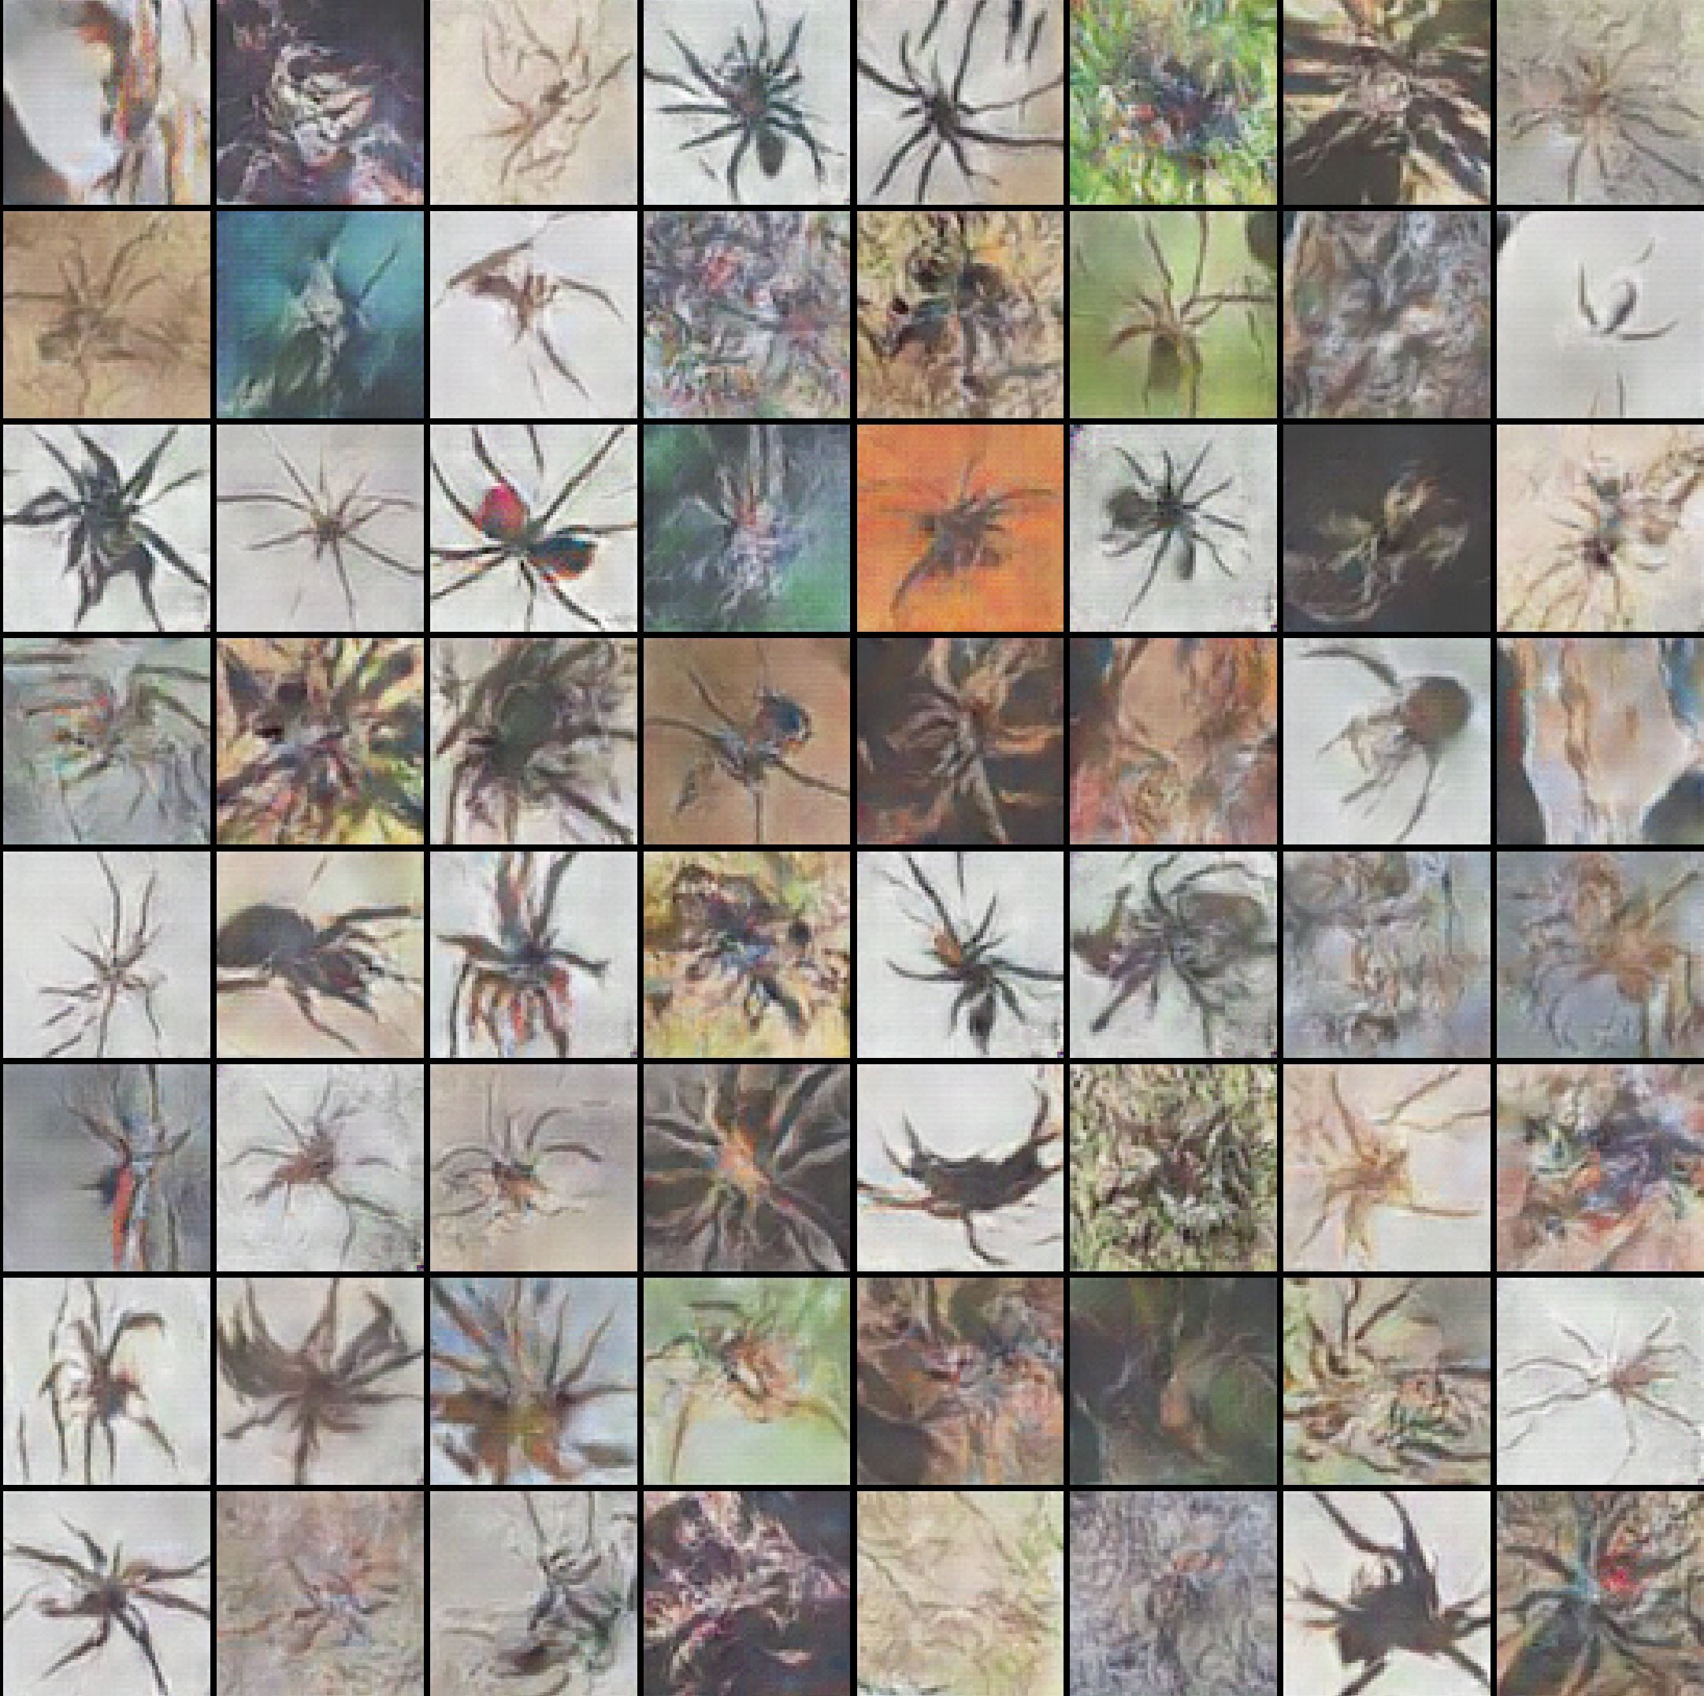
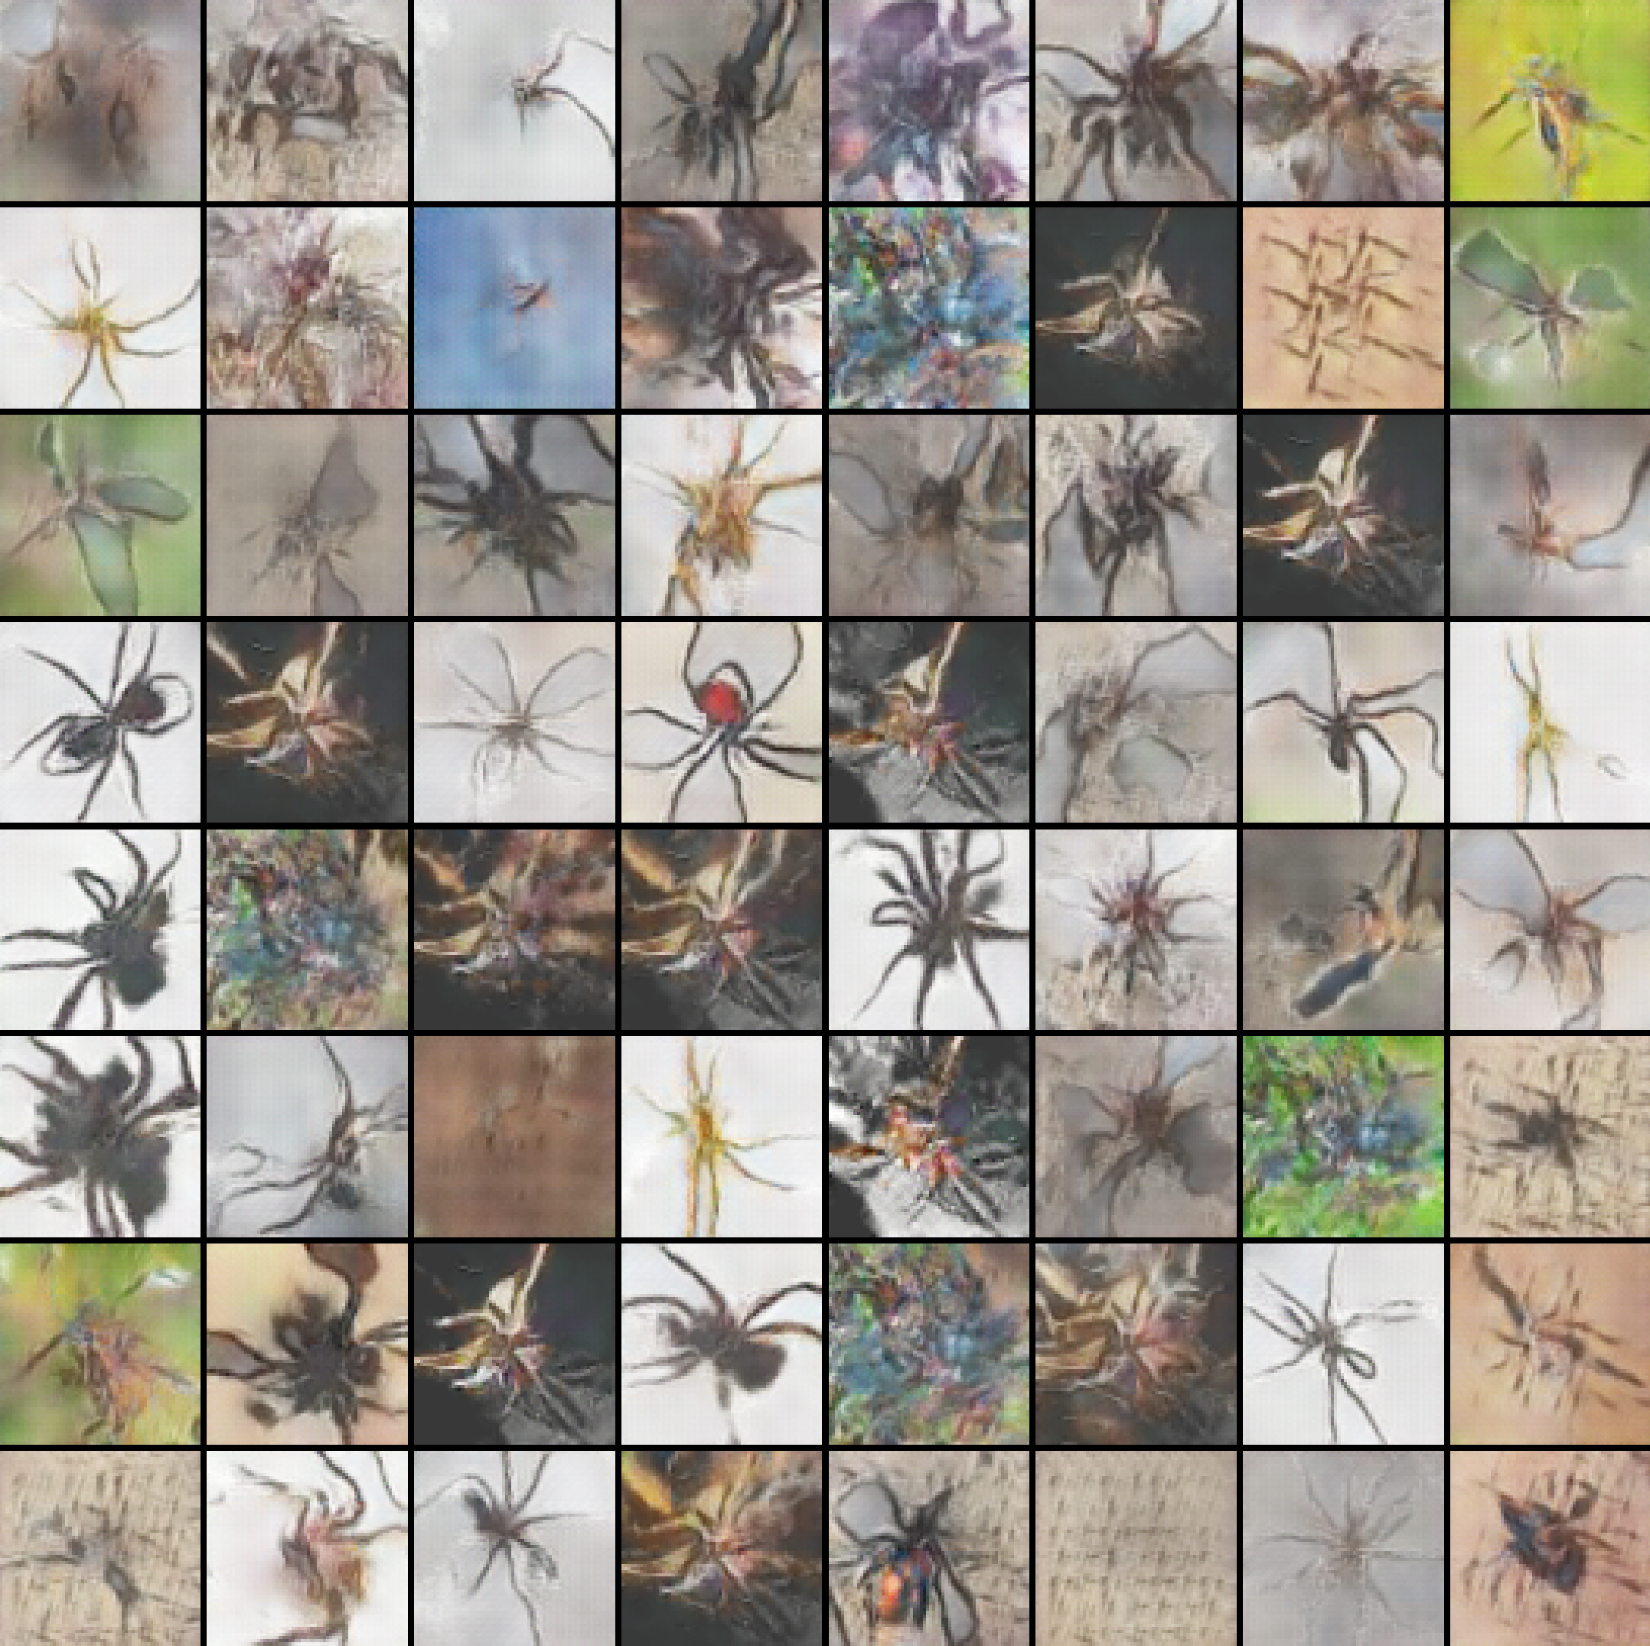
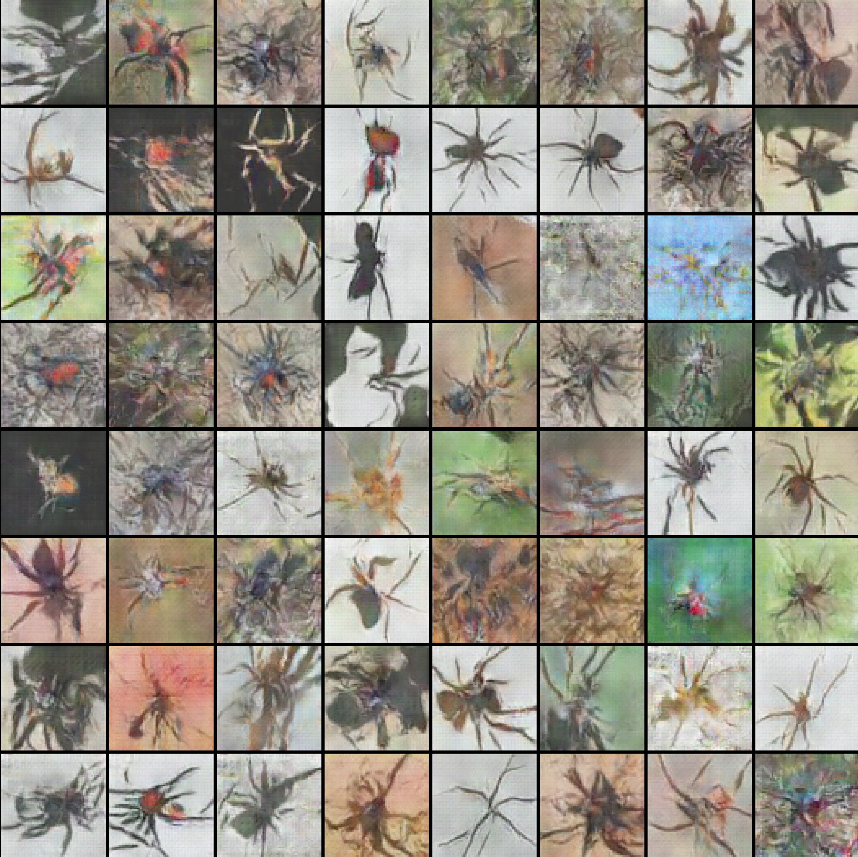
Introduction
Key concepts
Dataset & Results
Dataset
Results
Conclusions & future work
Results – Generated spiders (Influence of batch size) (Part2)
Picture: Generated spiders, batch size=512 [Adam(950 epoch); RMSprop(1000 epoch)]
Picture: Generated spiders, batch size=2048 [Adam(1200 epoch); RMSprop(1300 epoch)]
The size of the batch does not guarantee a qualitative and quantitative improvement in the generated spiders.
Images give the best results for batch size=512 for two optimizers (in my opinion). However, this is only a ‘superficial’ assessment, as it is visually difficult to determine exactly which of the results is the best.
Picture: Generated spiders, batch size=1024 [Adam(1300 epoch); RMSprop(1500 epoch)]
12/21

Slide 13
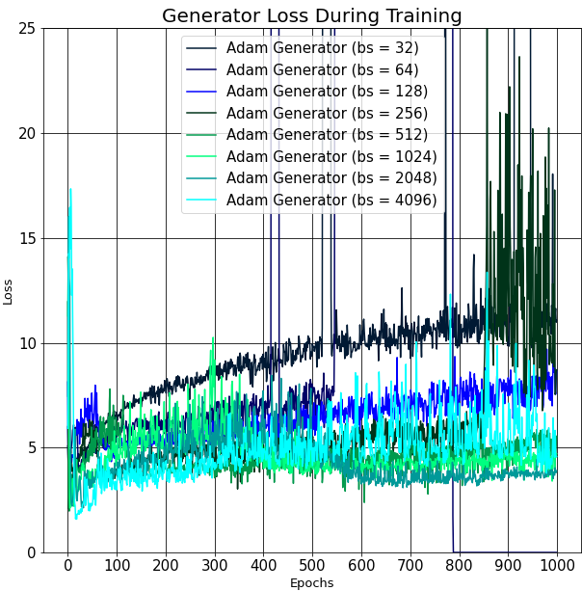
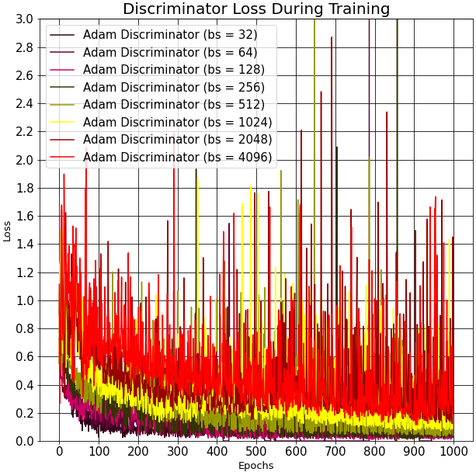
Introduction
Key concepts
Dataset & Results
Dataset
Results
Conclusions & future work
Results – Loss (Influence of batch size) (Part 1)
Picture: Generator loss, Adam optimizer, different batch size
Picture: Discriminator loss, Adam optimizer, different batch size
The generator loss of Adam decreases as the size of the batch increases. Larger the batch size, the more stable loss will occur later.
There’re some big peaks that most probably come due to a little size of batch.
The discriminator loss of Adam optimizer increases as the size of the batch increases.
13/21

Slide 14
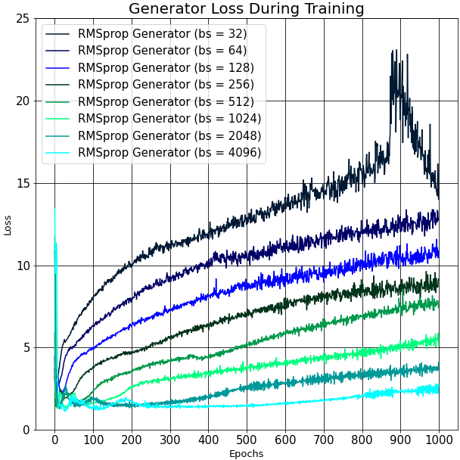
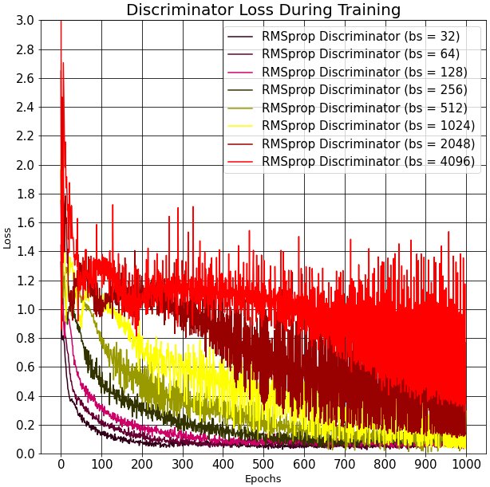
Introduction
Key concepts
Dataset & Results
Dataset
Results
Conclusions & future work
Results – Loss (Influence of batch size) (Part 2)
Picture: Generator loss, RMSprop optimizer, different batch size
Picture: Discriminator loss, RMSprop optimizer, different batch size
The generator loss of RMSprop decreases as the size of the batch increases.
The discriminator loss of RMSprop optimizer increases as the size of the batch increases.
14/21

Slide 15
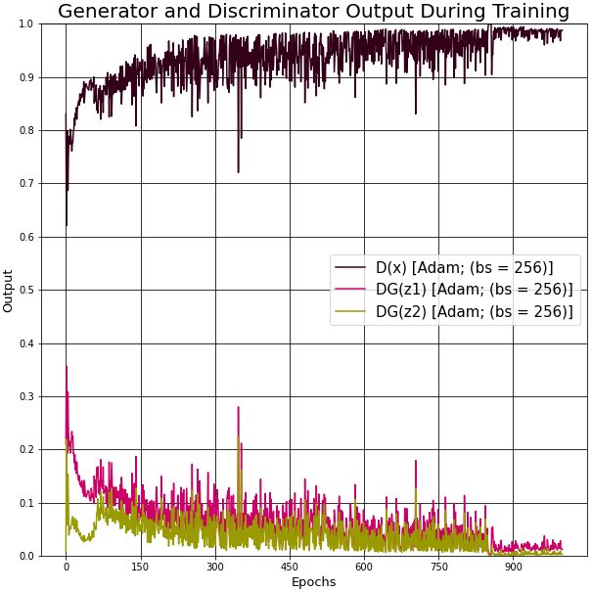
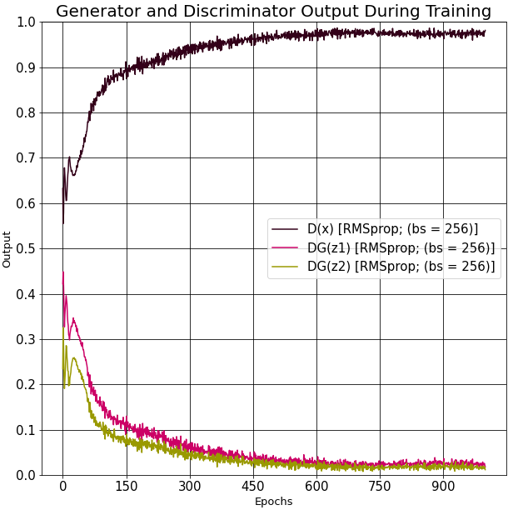




Introduction
Key concepts
Dataset & Results
Dataset
Results
Conclusions & future work
Results – Generator & Discriminator Outputs (Influence of batch size)
Picture: Output for batch size=256 [Adam(left); RMSprop(right)]
Picture: Output for batch size=4096 [Adam(left); RMSprop(right)]
The images demonstrate how the batch size influences to the outputs. The perfect situation for DCGAN model is when all the outputs are equal to 0.5.
The bigger the batch size is, the more errors the discriminator make and the less errors the generator make.
The best outputs are for a batch size=4096. However, the results of generated spiders are not so clear for this batch size
Picture: Output for batch size=1024 [Adam(left); RMSprop(right)]
15/21

Slide 16


















Introduction
Key concepts
Dataset & Results
Dataset
Results
Conclusions & future work
Results – Characteristics of new generated spiders
Picture: Different spider species
Picture: Spiders on different backgrounds
Picture: Background with easy distinguishable spiders
Picture: Example of image quality change during the training process
Picture: Spiders from different angles
Picture: Background with difficult distinguishable spiders
Picture: Spiders without certain
parts of the body
16/21
Picture: Example of a training process

Slide 17


Introduction
Key concepts
Dataset & Results
Dataset
Results
Conclusions & future work
Results – Generated spiders (Inception model)
Picture: Best generated spiders for inception model (Adam -1500 epoch(left); RMSprop – 450 epoch(right))
The quality of this spiders is much worse comparing with the spiders from the achieved spiders with the models discussed earlier.
Some of the examples have only noise. Most probably it was caused by complexity of the model or by overfitting.
17/21

Slide 18


Introduction
Key concepts
Dataset & Results
Dataset
Results
Conclusions & future work
Results – Loss (Inception model)
Picture: Adam loss for inception model
Picture: RMSprop loss for inception model
The discriminator loss is higher than a generator loss.
Both losses are small enough.
The generator loss is small enough
It could be expected good results for such small losses for both optimizers. Unfortunately, the generated spiders are not promising. Most probably, it's the problem of overfitting which often appears when the model is complicated enough.
18/21

Slide 19


Introduction
Key concepts
Dataset & Results
Dataset
Results
Conclusions & future work
Results – Output (Inception model)
Picture: Output for inception model: Adam - left; RMSprop – right
Outputs for Adam optimizer are almost ideal but the results are not good enough. This fact also proves the high probability of overfitting. RMSprop optimizer outputs look similar to the achieved outputs from the models discussed earlier.
19/21

Slide 20
Introduction
Key concepts
Dataset & Results
Dataset
Results
Conclusions & future work
Conclusions & future work
Different fake spiders have been achieved.
Generated spiders are with different characteristics.
The main disadvantage is that there's no NN that may generate different fake spiders of good quality continuously.
Other inception models may be implemented.
SGD optimizer can be checked for a bigger learning rate parameter.
Different hyperparameters tuning can be tried.
Other quality metrics may be used to determine accurately which result is better.
20/21

Slide 21
Thank you for your attention
21/21

